Slide 1
Evaluation of Quantitative Precipitation Estimation from Model, Satellite and Radar
Chongxing Fan
School of Atmospheric Sciences, Nanjing University
SUPERVISOR: Yongsheng Chen
Notes:
Good afternoon, everyone. My name is Chongxing Fan. I’m an undergraduate senior from Nanjing University and this summer I came here to do 3-month scientific research following Professor Yongsheng Chen. Today I’m going to present my results about evaluation of quantitative precipitation estimation from model, satellite and radar.

Slide 2
Contents
01
Introduction
02
Data and Method
03
Result Analyses
04
Conclusions
05
References
Notes:
I’ll divide it into five parts: Introduction, Data and method, Result analyses, conclusions and references.

Slide 3
Contents
01
Introduction
02
Data and Method
03
Result Analyses
04
Conclusions
05
References

Slide 4
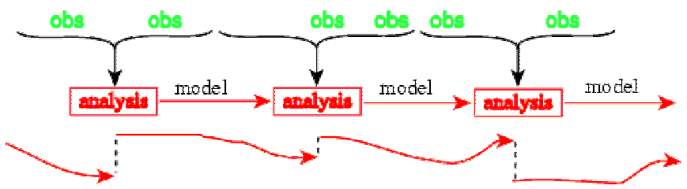
Introduction
Observation including satellite, radar and rain gauge data is combined with model to produce analysis field.
Error structure of observations and forecasts have to be understood to improve data assimilation.
Notes:
Improving weather forecasting is an eternal topic in Atmospheric Science, in which data assimilation plays an important part. Observation including satellite, radar and rain gauge data is combined with model output and produce the analysis field. In order to understand the error structure between these data sources, we conducted this research to evaluate model, satellite and radar estimates compared with rain gauge data.

Slide 5
Contents
01
Introduction
02
Data and Method
03
Result Analyses
04
Conclusions
05
References
Notes:
First of all, we have to get data prepared.

Slide 6
Data
3-km High-Resolution Rapid Refresh (HRRR) in CONUS area
Model: High-Resolution Rapid Refresh(HRRR)
Spatial Resolution: 3km
Temporal Resolution: 1h
Domain: CONUS
Real-time 3-km resolution, hourly updated, cloud-resolving, convection-allowing atmospheric model
Radar assimilation included
Notes:
We choose High-Resolution Rapid Refresh, abbreviated as HRRR as our model. The HRRR is a NOAA real-time 3-km resolution, hourly updated, cloud-resolving, convection-allowing atmospheric model. Radar data is assimilated in the HRRR every 15 min over an 1-h period. One hour precipitation is a variable in the HRRR’s output so we can use it directly.

Slide 7
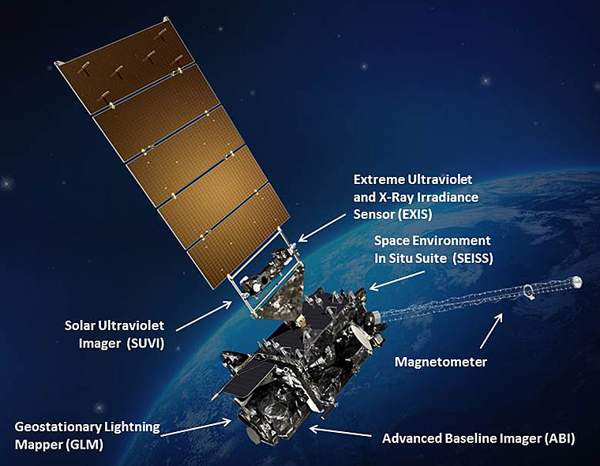
Data
Satellite Estimates: GOES-16 ABI L2+ RRQPE
Spatial Resolution: 2km
Temporal Resolution: 15mins
Domain: Full Disk
The ABI Rainfall Rate algorithm generates the baseline Rainfall Rate product from ABI IR brightness temperatures and is calibrated in real time against microwave-derived rain rates to enhance accuracy. The algorithm generates estimates of the instantaneous rainfall rate at each ABI IR pixel.
Notes:
Next is the GOES-R Series. The GOES-R primary instrument for imaging Earth is the Advanced Baseline Imager (ABI). ABI will view the Earth with 16 different spectral bands includes two visible channels, four near-infrared channels, and ten infrared channels. The ABI Rainfall Rate algorithm generates the baseline Rainfall Rate product from ABI IR brightness temperatures and is calibrated in real time against microwave-derived rain rates to enhance accuracy.

Slide 8
Data
Radar + Gauge Estimates: StageIV
Spatial Resolution: 4km
Temporal Resolution: 1h
Domain: CONUS
Mosaicked into a national product at NCEP, from the regional hourly/6-hourly multi-sensor (radar+gauges) precipitation analyses (MPEs) produced by the 12 River Forecast Centers over CONUS.
Snapshot of a one-hour Stage II (left) and Stage IV (right) analysis.
Notes:
Then we choose StageIV as radar estimates. It is actually a combination of radar and gauge estimates. But since the station-based rain gauge data is sparsely distributed, this high-resolution dataset mainly depends on the radar observation.

Slide 9
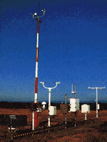
Data
Observation: METAR
Spatial Resolution: 2388 stations
Temporal Resolution: ~5mins
Domain: CONUS
Heated Tipping Bucket (HTB) Precipitation Gauge
Precipitation Accumulation Algorithm
Notes:
Finally METAR station-based observation is selected as a reference dataset. It uses heated tipping bucket precipitation gauge to measure precipitation and employs precipitation accumulation algorithm to retrieve the rainfall rate.

Slide 10
Method
Preprocessing
Interpolation
HRRR
H_std
GOES
G_std
Plot
Eyeball Verification
Radar
R_std
METAR
M_std
Combined
Preprocessing
Statistical Verification
Combination
Analyze
Notes:
In order to compare these four datasets, we have to preprocess them to become an hourly data with standard units. Because these datasets don’t have the same grid, especially for METAR, which is unstructed grid, we have to interpolate HRRR, GOES and radar data into METAR grid. After interpolation and combination we can either plot the rainfall rate of each hour to see the spatial pattern and rain rate with our eyes, or do the statistical analyses using various statistical methods. In this study we mainly do the latter one.

Slide 11
Contents
01
Introduction
02
Data and Method
03
Result Analyses
04
Conclusions
05
References
Notes:
Now I’d like to show you the results.

Slide 12
Result Analyses
We choose July 2018 for our analyses.
Several verification methods are employed.
Average Rainfall Maps/Trends
Probability Distribution Function (PDF) Plots
Average, Variance, Skewness and Kurtosis
Contingency Table
Correlation Analysis
Verification for Dichotomous Forecasts/Estimates
Notes:
We choose July 2018 for our analyses. These methods are employed in our analyses, such as……

Slide 13
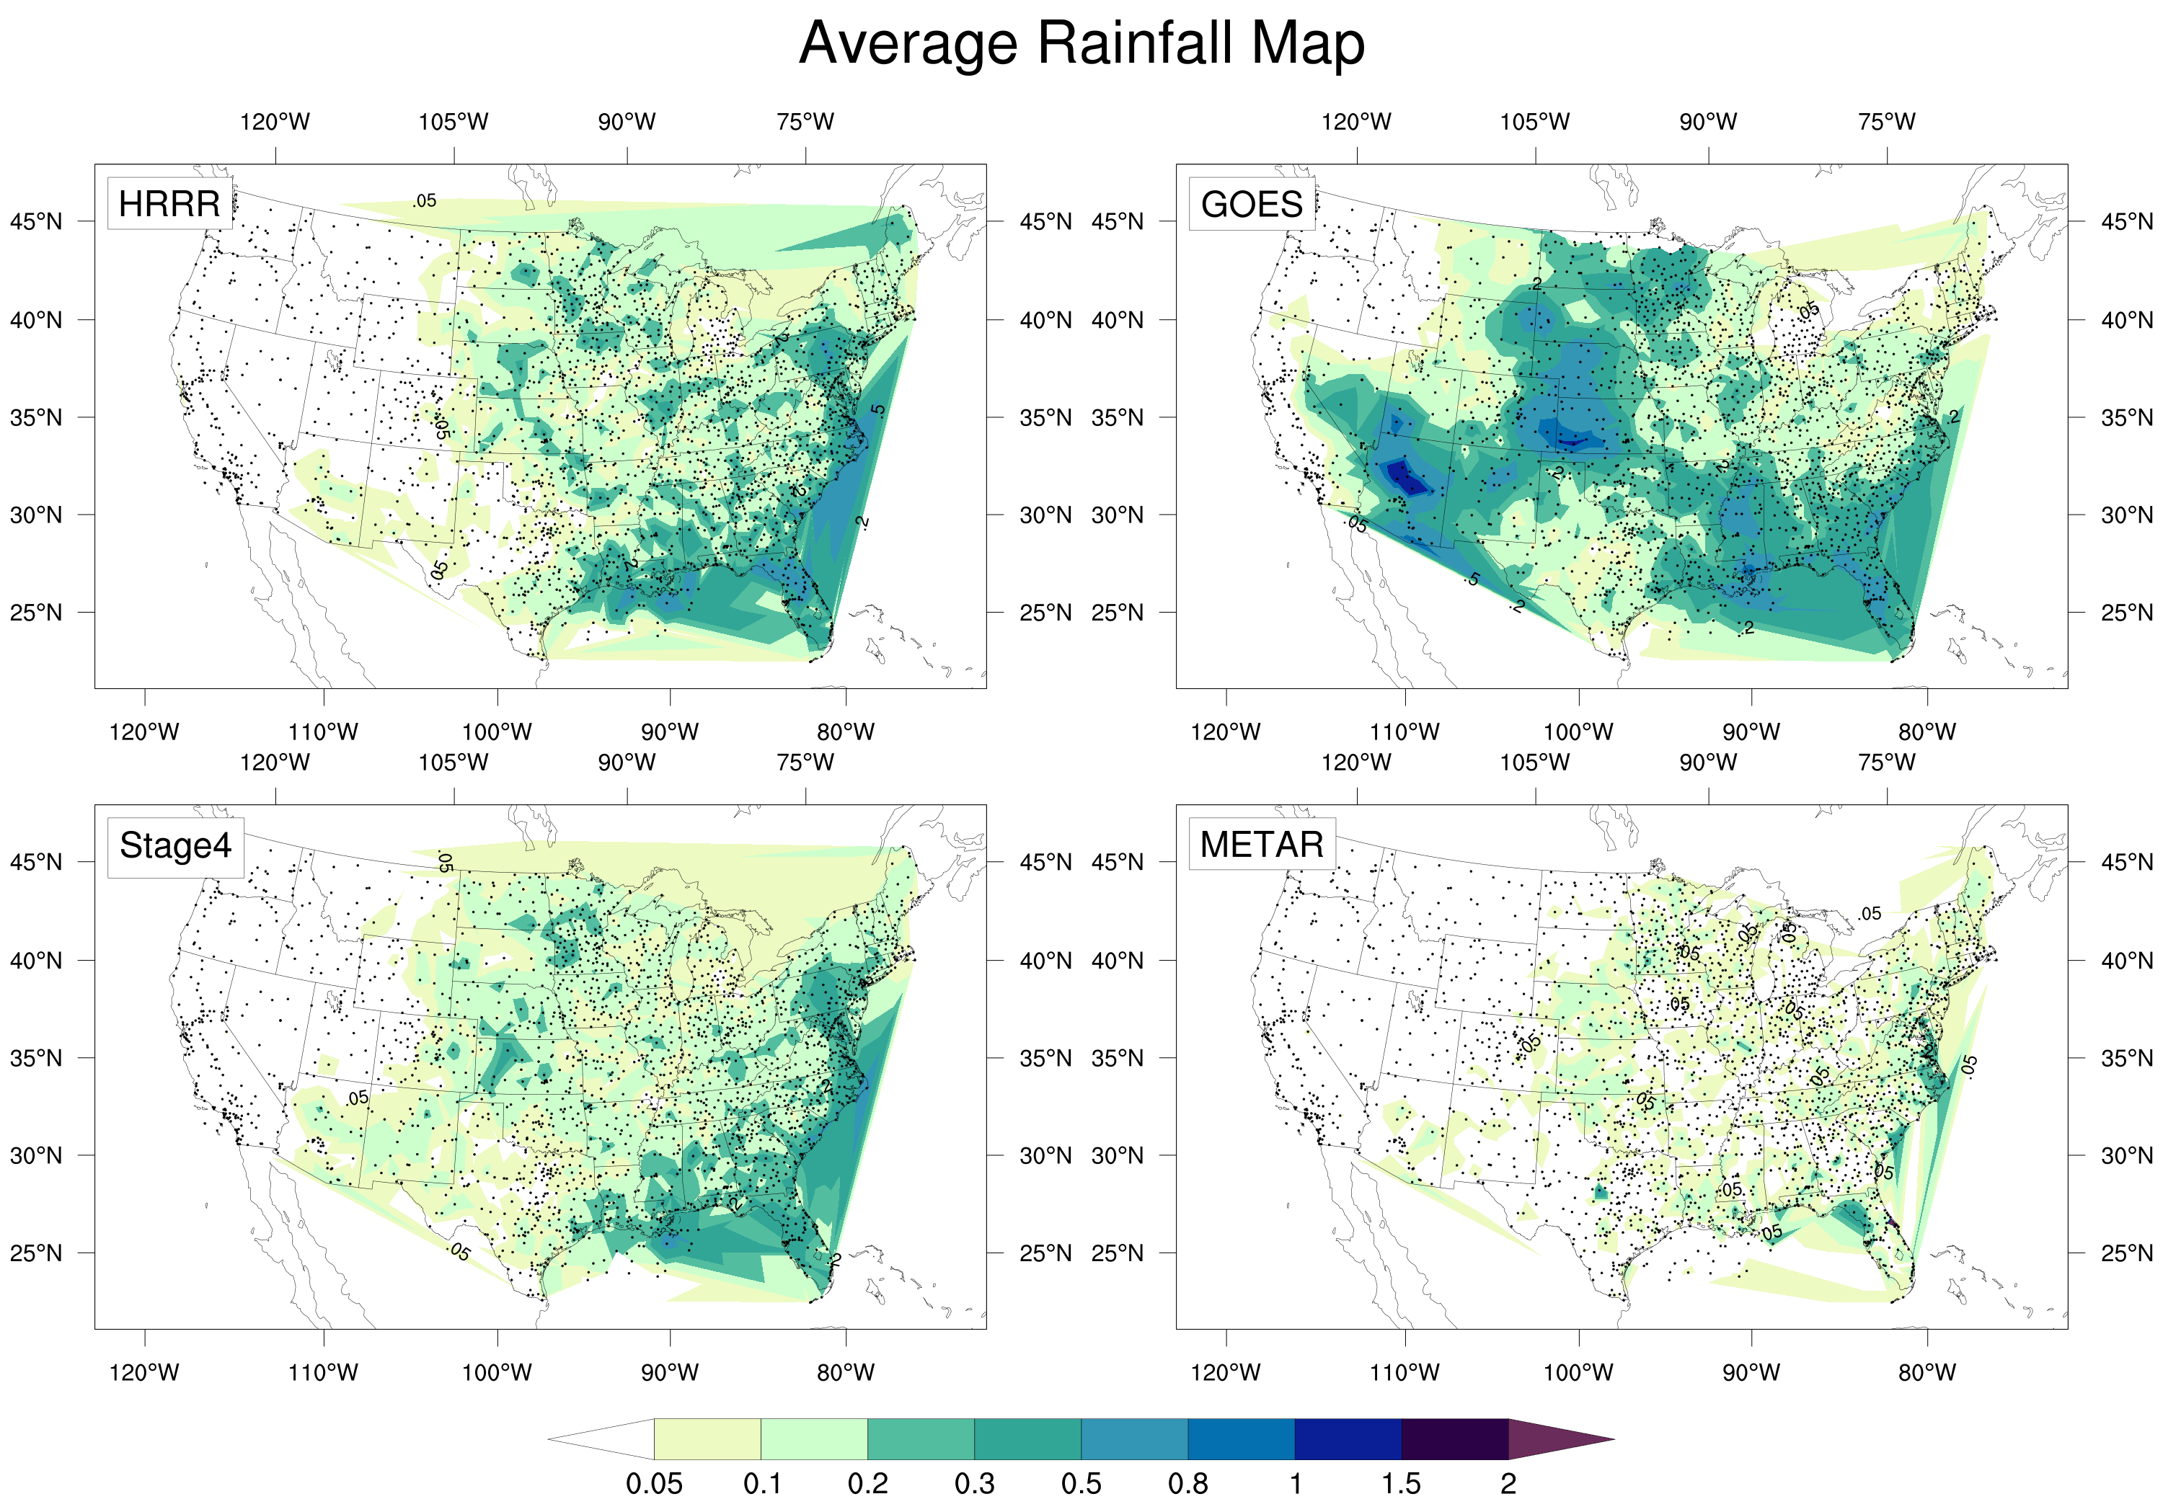
Total precipitation
HRRR: 109.635 mm
GOES: 152.617 mm
Stage4: 99.497 mm
METAR: 48.651 mm
Significant wet bias in forecasts and estimates, especially in GOES estimate.
HRRR
GOES
Stage4
METAR
Notes:
First of all, this is the average rainfall map. Accordingly, these four panels show the HRRR model, GOES satellite, Stage4 multisensory and METAR rain gauge data. They all have been time-averaged so we can draw this single map. Color indicates one hour precipitation value. Total precipitation is listed here. From the plot we can see a significant wet bias in these three datasets when compared with METAR, especially for GOES satellite estimation. You can see in the west US there are some area in blue.

Slide 14
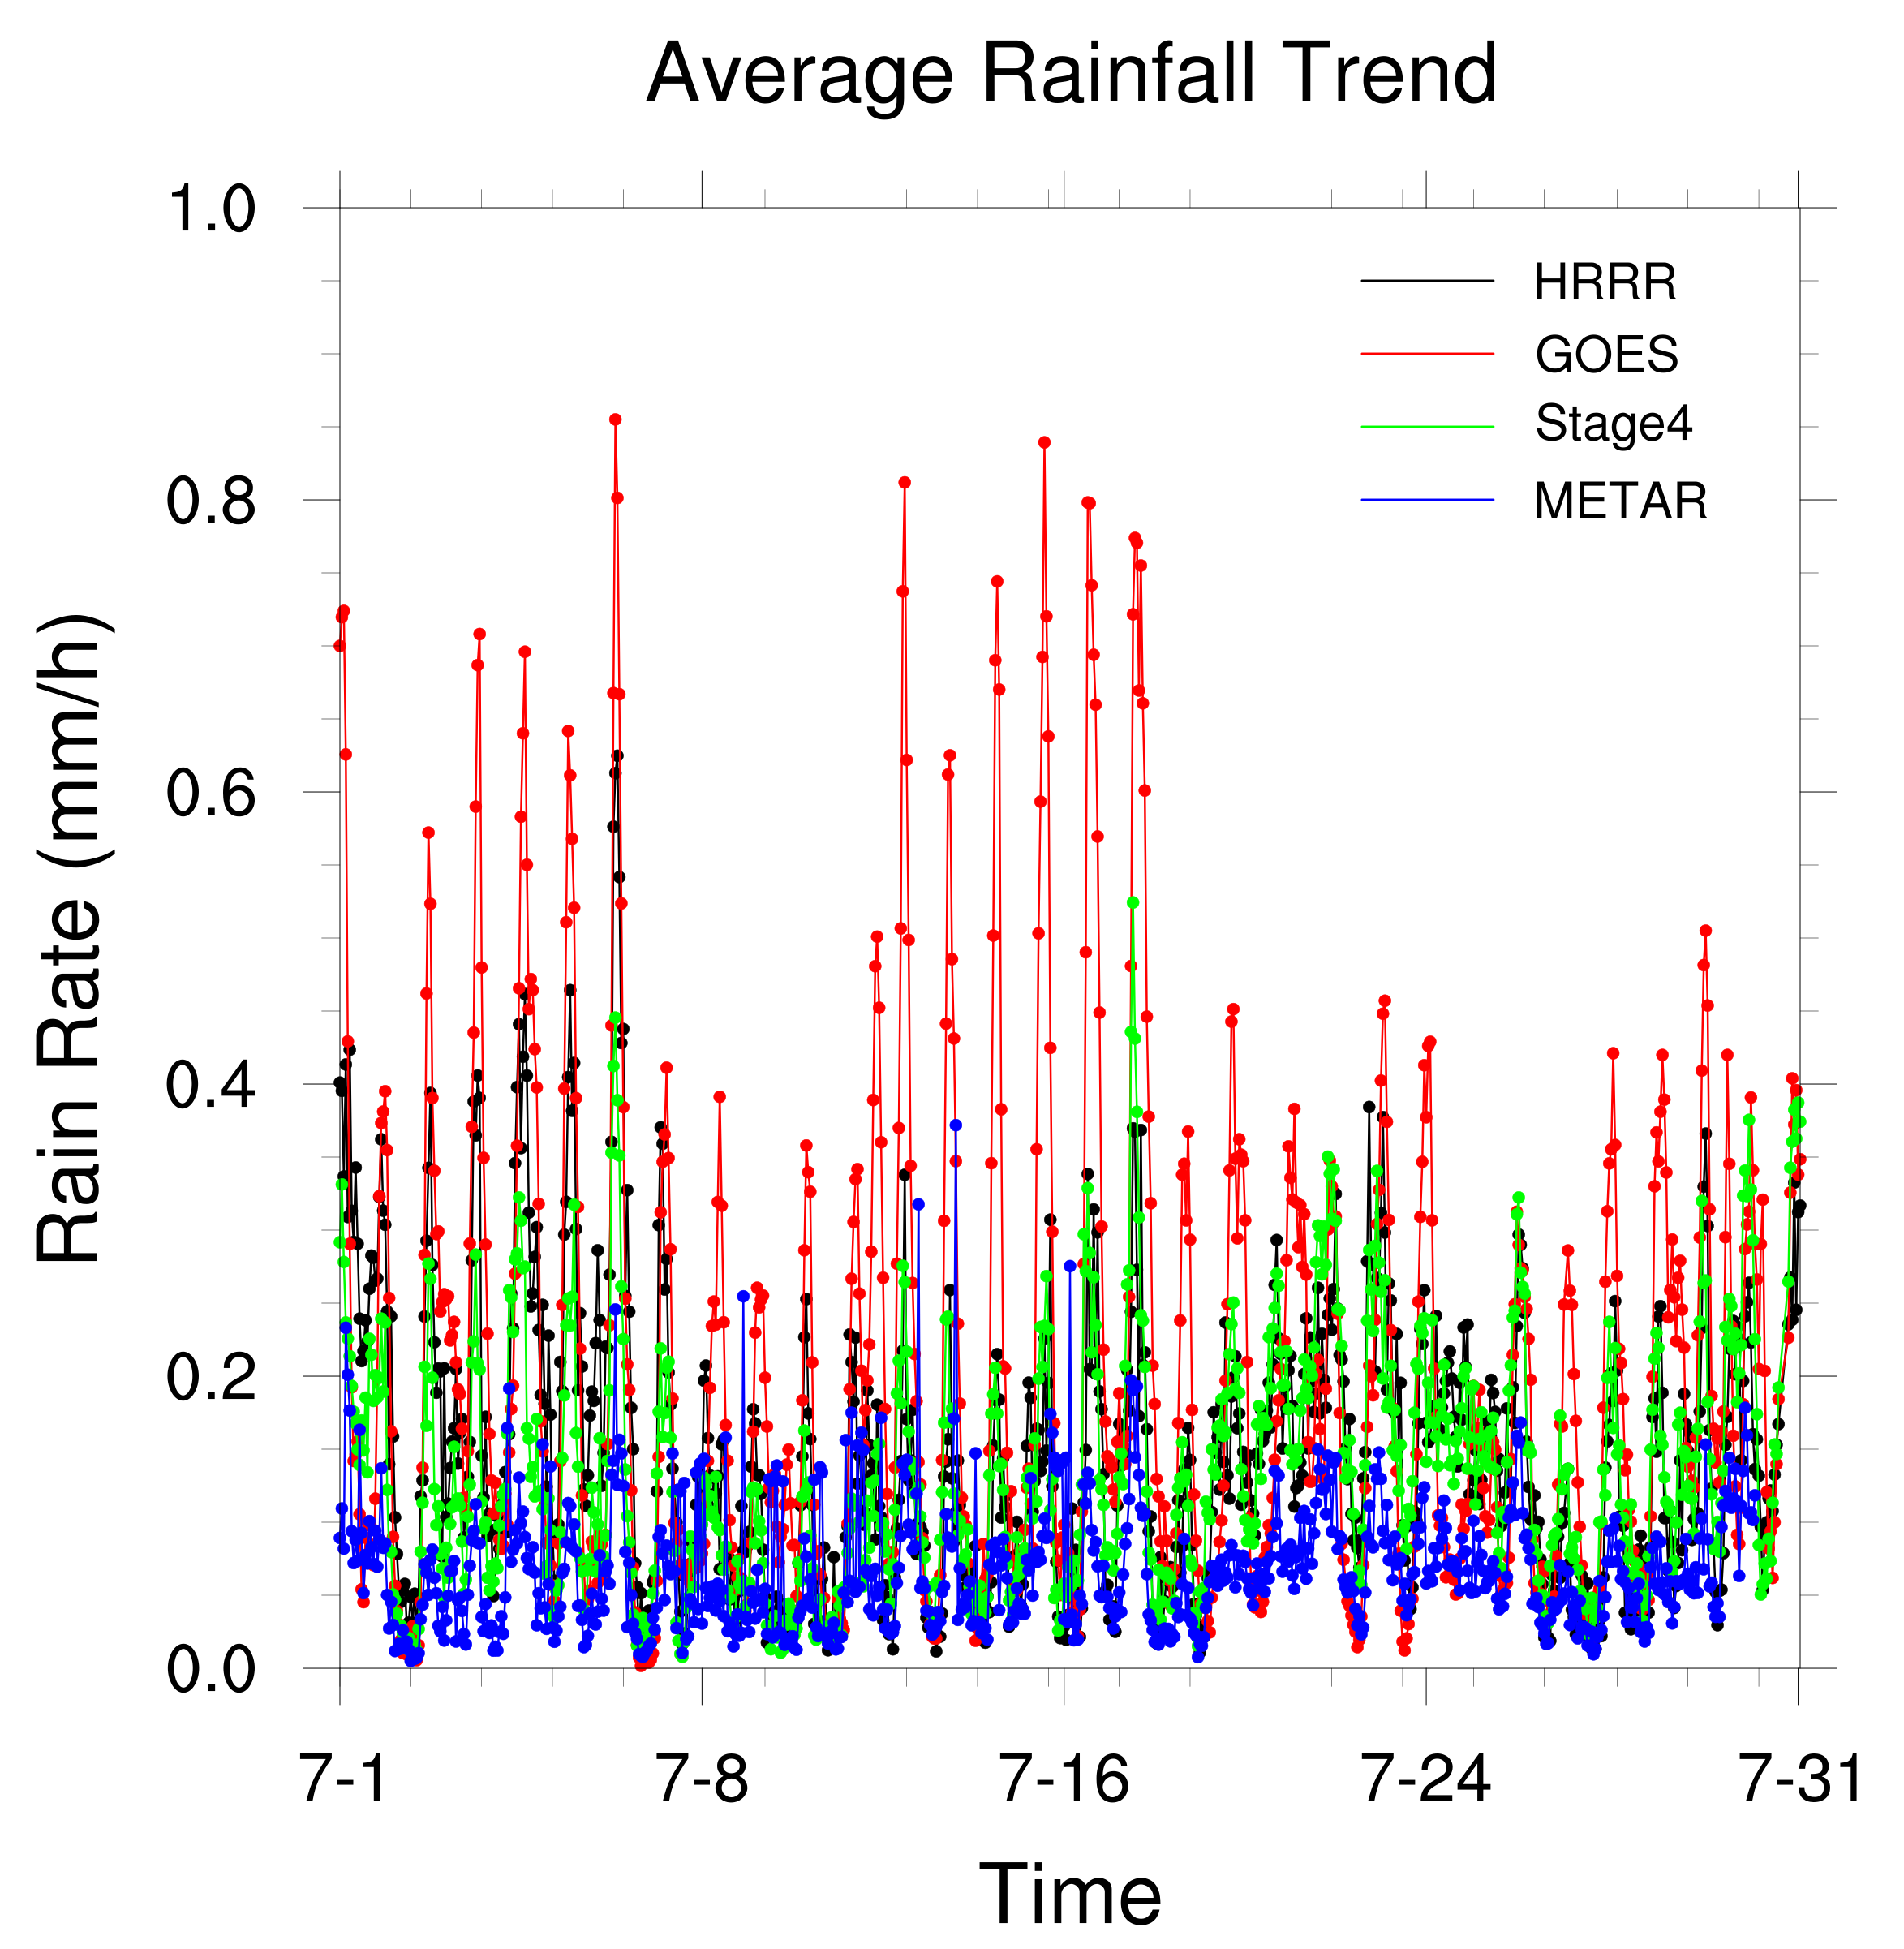
Total precipitation
HRRR: 109.635 mm
GOES: 152.617 mm
Stage4: 99.497 mm
METAR: 48.651 mm
Short and heavy rainfall occurs periodically.
All forecasts and estimates show a wet bias, with the GOES having the largest bias.
HRRR
GOES
Stage4
METAR
Notes:
For the average rainfall trend, we can see four curves in this trend plot. Black is HRRR model, red is GOES satellite, green is Stage4 and blue is METAR. They all have been spatial-averaged across more than 2000 stations so we can draw this single trend plot. We can see that in July short and heavy rainfall occurs periodically, and if we count the peaks in the plot we know that it seems like a diurnal variation. Also wet bias can be seen in this time-series plot. HRRR and Stage4 seem to be close to each other.

Slide 15
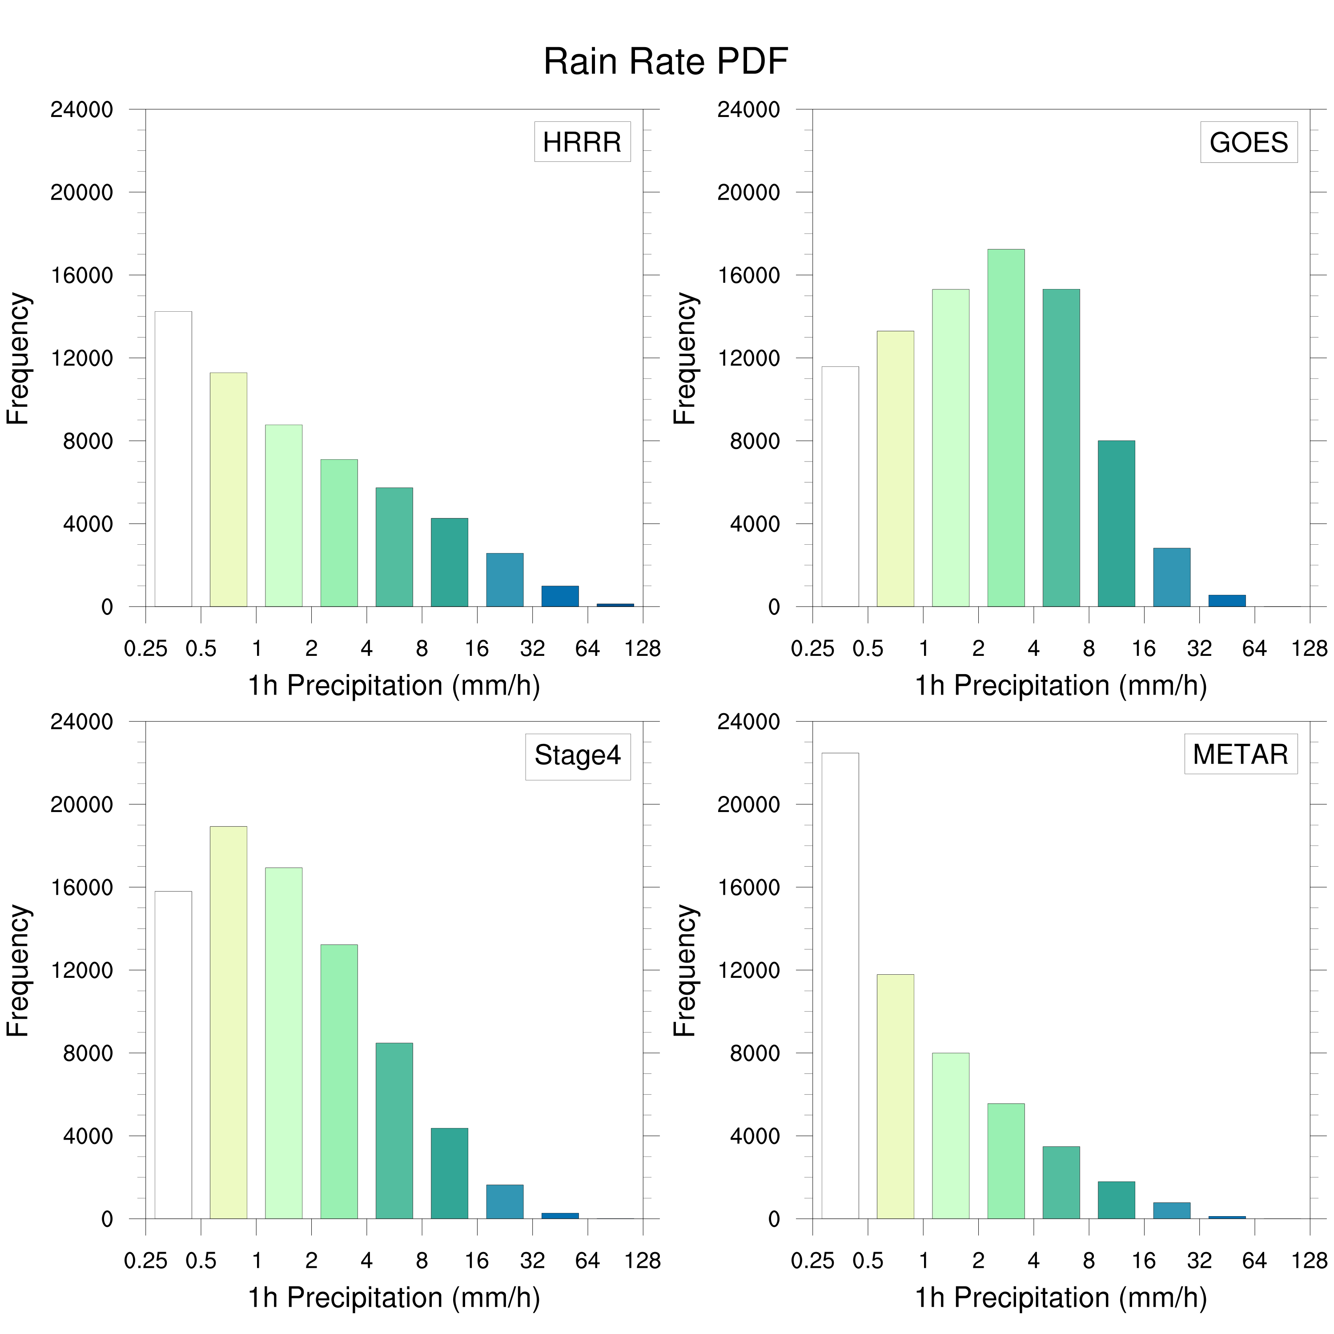
Probability Distribution Function (PDF) plot can clearly show the data distribution.
Compared with METAR, rain rate PDF of GOES satellite shifts to the right, suggesting a wet bias to the observation.
HRRR
GOES
Stage4
METAR
Notes:
Apart from the average map or trend, we can also set some thresholds and analyze the distribution of rain rate. PDF plot can clearly show the data distribution. Here X axis is 1h precipitation and Y is frequency. When compared with METAR, we can see all the three datasets have a right shift, showing a wet bias, which is consistent to the previous result.

Slide 16
Table: Basic Statistics of Error
 | ALL |  |  |  | LIGHT
 | AVG | VAR | SKW | KUR | AVG | VAR | SKW | KUR
HRRR | 0.09 | 3.64 | -25.30 | 9811 | 1.16 | 56.43 | 5.05 | 35.82
GOES | 0.14 | 3.46 | -53.91 | 12770 | 0.55 | 25.85 | 3.72 | 18.90
Stage4 | 0.07 | 1.62 | -123.28 | 47910 | 1.12 | 18.39 | 6.75 | 82.47
Occurrence Frequency
Generally, there is a wet bias during light rain and dry bias during heavy rain.
Because Stage4 combines radar and rain gauge data, it is the most accurate estimate among the three datasets.
5272
892
1630877
13551
 | MEDIUM |  |  |  | HEAVY
 | AVG | VAR | SKW | KUR | AVG | VAR | SKW | KUR
HRRR | -2.96 | 93.95 | 3.17 | 14.03 | -17.27 | 184.74 | 1.43 | 5.46
GOES | -3.43 | 44.67 | 2.12 | 7.52 | -16.43 | 114.88 | 0.38 | 2.51
Stage4 | -0.45 | 29.10 | 2.69 | 15.47 | -7.63 | 101.87 | 0.13 | 1.63
Notes:
Here are some statistics about the error. We split the samples into four categories. “All” means all data is included in the calculation, and we set thresholds for light rain, medium rain and heavy rain. Four basic values are shown here: average, variance, skewness and kurtosis. Here we highlight the results of average error. It is shown that there is an overall slight wet bias in these three QPEs. There is a wet bias during light rain while significant dry bias during heavy rain. But since the occurrence of the heavy rain is much smaller than of the light rain, so the overall average error is a wet bias. Furthermore, absolutely the Stage4 has the best performance among these three estimations.

Slide 17
Diagram: Using 1mm/h as threshold to distinguish rain and non-rain area
False Alarms
Hits
Forecast / Estimates
1 mm/h
Correct Negatives
Misses
1 mm/h
Observation
Notes:
To further evaluate the performance of these estimations, we employ some terms here. We define 1 mm/h as threshold to distinguish rain and non-rain area. After splitting the panel into four sections, we can define them accordingly as Hits, Misses, False Alarms and Correct Negatives.

Slide 18
Table: Contingency Table
 | HRRR |  | GOES |  | Stage4
METAR | YES | NO | YES | NO | YES | NO
YES | 7402 | 11017 | 8057 | 10770 | 15628 | 2790
NO | 20501 | 1.50532e+06 | 47463 | 1.50348e+06 | 26404 | 1.48620e+06
Stage4 has the largest hits and smallest misses.
HRRR has the largest misses, while GOES has the largest false alarms.
 |  | Forecasts/Estimates
 |  | YES | NO
Observation | YES | Hits | Misses
 | NO | False Alarms | Correct Negatives
Notes:
Therefore we can make this contingency table. Corresponding term for each cell is shown here as a table. As we can see in this table, StageIV has the largest hits and smallest misses. What’s new to us is that HRRR has the largest misses and GOES has the largest false alarms.

Slide 19
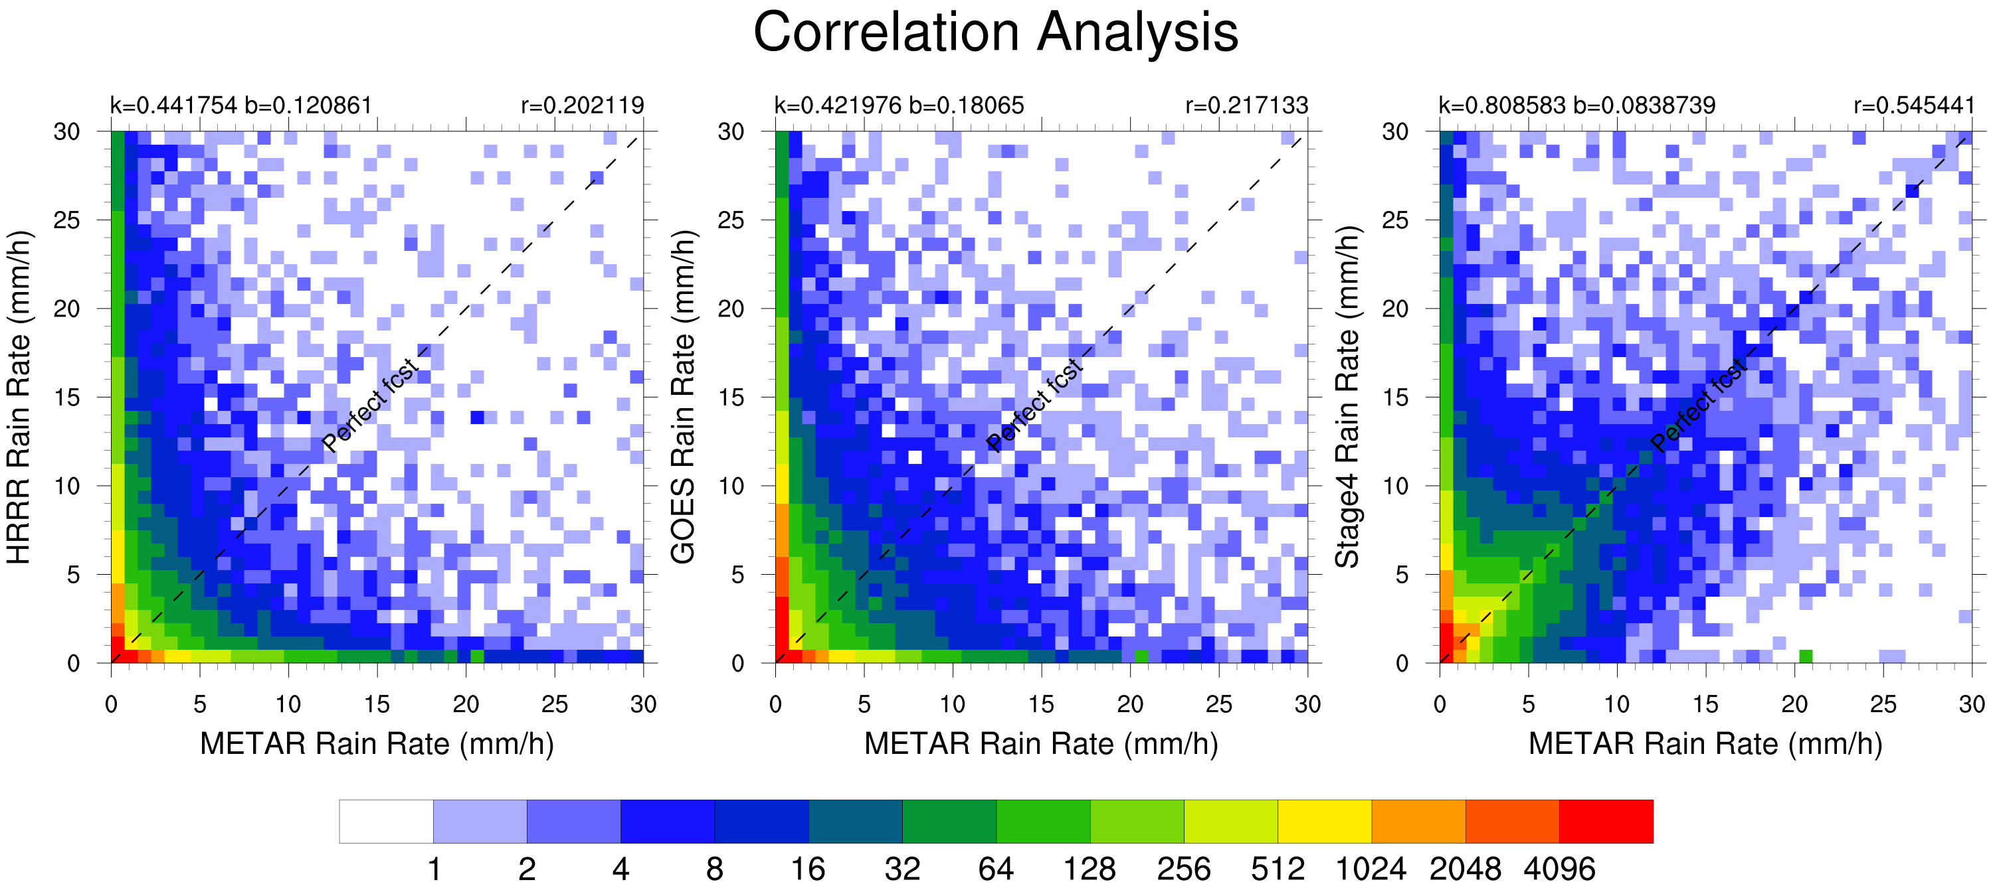
Perfect Forecast
Notes:
To understand the correlation between estimation and observation, we perform the correlation analysis. The black dash line is drawn as a perfect forecast or perfect estimation line. Color indicates the density of the scatter points. We also calculate the linear regression coefficients which are marked in this plot. From the plot, we know that the improvement for the StageIV is shown in this square area. There are fewer misses in StageIV, and samples are gathered close to this perfect forecast line, and thus result in a higher R value.

Slide 20
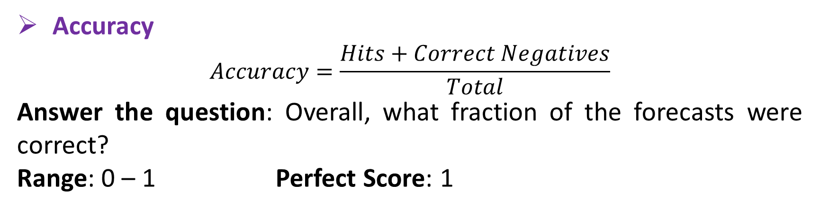
Forecast and Estimates Verification for July 2018
Verification Methods for Dichotomous Forecasts
Accuracy
$$Accuracy=\frac{Hits+Correct Negatives}{Total}$$
Answer the question: Overall, what fraction of the forecasts were correct?
Range: 0 – 1 Perfect Score: 1
Notes:
Using these results, finally we present some scores that can measure the performance of these three datasets. Let’s review these scores first before we continue.

Slide 21
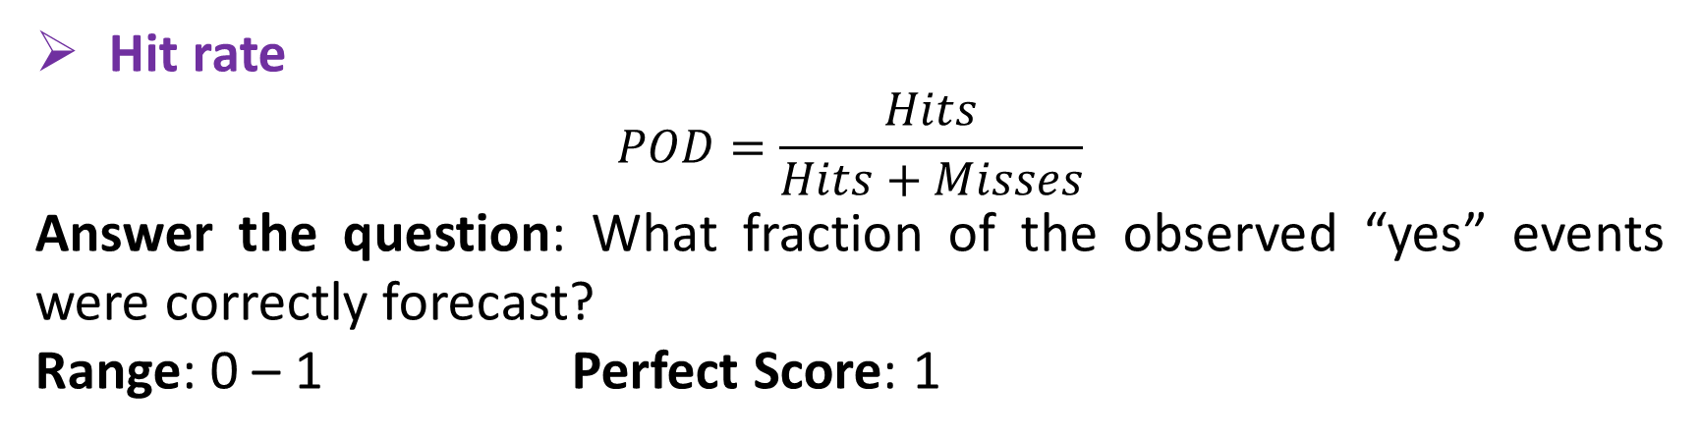
Forecast and Estimates Verification for July 2018
Verification Methods for Dichotomous Forecasts
Hit rate
$$POD=\frac{Hits}{Hits+Misses}$$
Answer the question: What fraction of the observed “yes” events were correctly forecast?
Range: 0 – 1 Perfect Score: 1

Slide 22
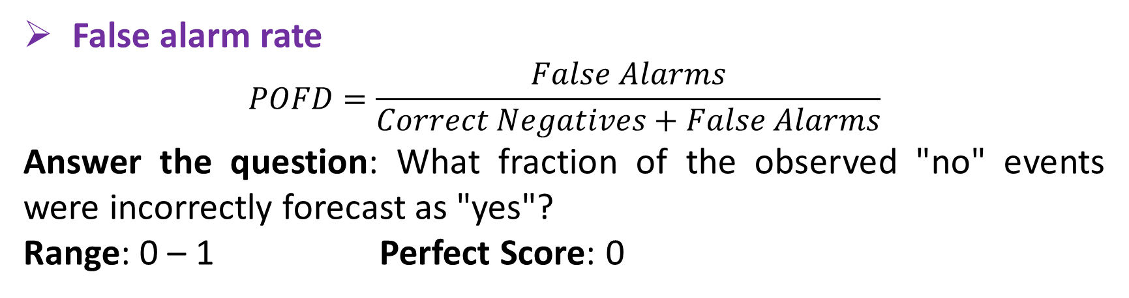
Forecast and Estimates Verification for July 2018
Verification Methods for Dichotomous Forecasts
False alarm rate
$$POFD=\frac{False Alarms}{Correct Negatives+False Alarms}$$
Answer the question: What fraction of the observed "no" events were incorrectly forecast as "yes"?
Range: 0 – 1 Perfect Score: 0

Slide 23
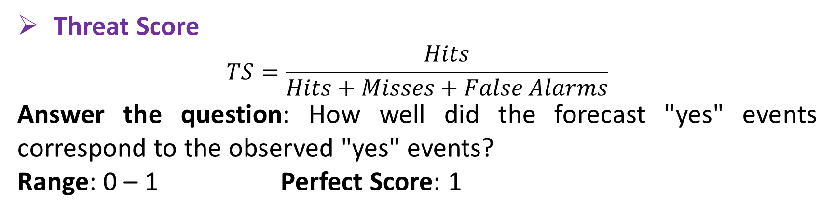
Forecast and Estimates Verification for July 2018
Verification Methods for Dichotomous Forecasts
Threat Score
$$TS=\frac{Hits}{Hits+Misses+False Alarms}$$
Answer the question: How well did the forecast "yes" events correspond to the observed "yes" events?
Range: 0 – 1 Perfect Score: 1

Slide 24
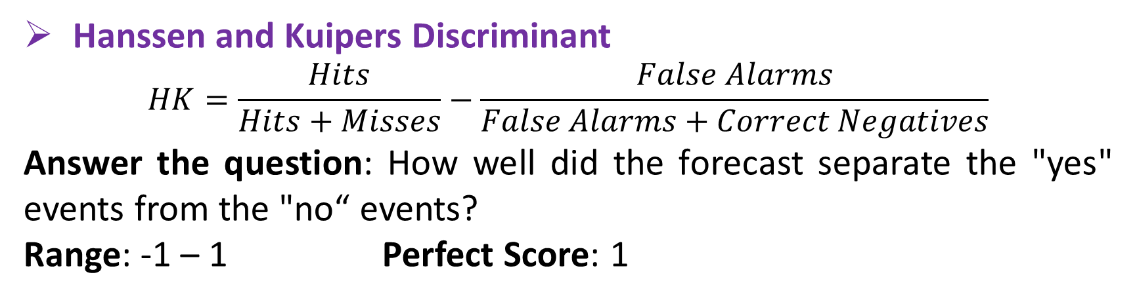
Forecast and Estimates Verification for July 2018
Verification Methods for Dichotomous Forecasts
Hanssen and Kuipers Discriminant
$$HK=\frac{Hits}{Hits+Misses}−\frac{False Alarms}{False Alarms+Correct Negatives}$$
Answer the question: How well did the forecast separate the "yes" events from the "no“ events?
Range: -1 – 1 Perfect Score: 1

Slide 25
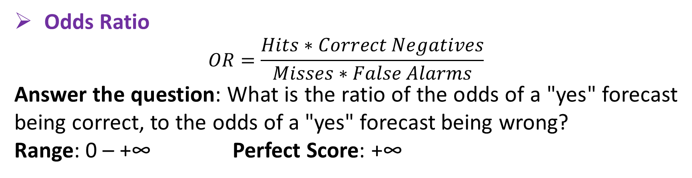
Forecast and Estimates Verification for July 2018
Verification Methods for Dichotomous Forecasts
Odds Ratio
$$OR=\frac{Hits∗Correct Negatives}{Misses∗False Alarms}$$
Answer the question: What is the ratio of the odds of a "yes" forecast being correct, to the odds of a "yes" forecast being wrong?
Range: 0 – +∞ Perfect Score: +∞

Slide 26
Forecast and Estimates Verification for July 2018
Table: Verification Results for Dichotomous Forecast and Estimates
 | HRRR | GOES | Stage4 | Range / Perfect
Accuracy | 0.979590 | 0.962903 | 0.980932 | 0 – 1 / 1
Bias Score | 1.514903 | 2.948956 | 2.282115 | 0 – inf / 1
Hit Rate | 0.401868 | 0.427949 | 0.848518 | 0 – 1 / 1
False Alarm Ratio | 0.734724 | 0.854881 | 0.628188 | 0 – 1 / 0
False Alarm Rate | 0.013436 | 0.030603 | 0.017456 | 0 – 1 / 0
Threat Score | 0.190185 | 0.121542 | 0.348668 | 0 – 1 / 1
HK Discriminant | 0.388432 | 0.397346 | 0.831062 | -1 – 1 / 1
Odds Ratio | 49.3331 | 23.6973 | 315.2873 | 0 – inf / inf
Odds Ratio Skill Score | 0.960265 | 0.919019 | 0.993677 | -1 – 1 / 1
Generally, Stage4 has the best performance.
For most scores, HRRR does better than GOES, and for some others in reverse.
Notes:
So here is the result. I use green, yellow and red to indicate good, medium and bad among these three datasets. Apparently StageIV has the best performance, while HRRR and GOES have their own strengths.

Slide 27
Contents
01
Introduction
02
Data and Method
03
Result Analyses
04
Conclusions
05
References

Slide 28
Conclusions
One hour precipitation obtained from HRRR model, GOES satellite, StageIV multisensory data and METAR rain gauge data are evaluated using various methods.
All QPEs have an overall wet bias. There is significant wet bias during light rain and significant dry bias during heavy rain.
Generally, StageIV has the best performance in evaluating precipitation, since it is a combination of radar and rain gauge.
HRRR has more misses, while GOES has more false alarms.
Notes:
So in conclusion, we perform an evaluation between model, satellite, radar and rain gauge data. Several verification methods are used. And we present to you some main conclusions. Firstly, All QPEs have an overall wet bias. When categorized to different rain rate, we know that significant wet bias occurs during light rain and significant dry bias occurs during heavy rain. Secondly, StageIV has the best performance in evaluating precipitation, since it is a combination of radar and rain gauge. And finally, HRRR has more misses, while GOES has more false alarms, which makes them have their own better scores than each other.

Slide 29
Conclusions
Further study:
More characteristics of the error structure
Causes of these phenomena
How to improve the precipitation estimation
Notes:
Further study may include how to find out more characteristics of the error structure of these datasets, the causes of these phenomena and how to improve the precipitation estimation.

Slide 30
Contents
01
Introduction
02
Data and Method
03
Result Analyses
04
Conclusions
05
References

Slide 31
Acknowledgements
Thanks to Professor Chen for supervising my research.
Thanks to Mitacs and CSC for the opportunity and financial support.
Thanks to my family for their support.
Notes:
That’s all about my results. Thanks to Professor Chen for supervising my project. He gave me many helpful advices during the short 3-month research. Also thanks to Mitacs and China Scholarship Council for providing opportunities and financial supports. Finally thanks to my family for their strong support behind me. Thank you for your listening!

Slide 32
References
Blaylock, B.K., Horel, J.D., Liston, S.T., 2017. Cloud archiving and data mining of High-Resolution Rapid Refresh forecast model output. Computers & Geosciences 109, 43–50. doi:10.1016/j.cageo.2017.08.005
Ebert, B., 2009. Forecast Verification - Issues, Methods and FAQ [WWW Document]. URL http://www.cawcr.gov.au/projects/verification/verif_web_page.html

Slide 33
Thank you for listening!

Slide 34
Supplement Materials

Slide 35
Data
Radar + Gauge Estimates: StageII
Spatial Resolution: 4km
Temporal Resolution: 1h
Domain: CONUS
National multi-sensor hourly precipitation analysis, based on hourly radar precipitation estimates from the ~140 WSR-88D radars over CONUS, and the ~3,000 automated gauge reports transmitted via the GOES Data Collection Platform.
Snapshot of a one-hour Stage II (left) and Stage IV (right) analysis.

Slide 36
ABI Rainfall Rate Algorithm
The rain rate algorithm identifies raining pixels and derives rain rates on a pixel level in ABI imagery. Its calibration is based on matches of ABI data with microwave (MW)-derived rainfall rates, which are considered to be the most accurate estimates of instantaneous rainfall rate available from satellite data. The ABI rain rate algorithm is based on the Self-Calibrating Multivariate Precipitation Retrieval (SCaMPR) algorithm first described in Kuligowski (2002).

Slide 37
ABI Rainfall Rate Algorithm
The algorithm derives rainfall rate fields in two steps:
Identify pixels that are experiencing rainfall. The predictors and predictor coefficients for detecting rainfall are derived using discriminant analysis in a calibration against MW-retrieved rainfall areas.
Retrieve rainfall rates for pixels where rainfall has been detected. The predictors and predictor coefficients for retrieving rainfall rate are derived using stepwise forward linear regression in a calibration against MW-retrieved rainfall rates.

Slide 38
About StageIV
In late 2001 NCEP began to routinely generate another national multi-sensor analysis, the “NCEP Stage IV”, mosaicked from the regional multi-sensor 1h and 6h analyses produced by the 12 ConUS RFCs.
The regional analyses done at the RFCs use more advanced versions of the multi-sensor analysis algorithm (e.g. Fulton and Kondragunta, 2002) and benefit from some manual quality control (QC) steps at the RFCs. Each RFC typically generate each hourly/6-hourly analysis twice, the first in the automated mode, done soon after the end of the accumulation time period, with no manual QC. The analysis is rerun several hours later in manual mode, where manual QC is performed by a human analyst.

Slide 39
About StageIV
At NCEP, the mosaicking for each hour/6-hour period is done via the following steps:
Gather all regional analyses available for that accumulation period; map the regional grid values to the national HRAP grid.
If a point on the national HRAP grid falls into one of the RFC’s domain, then the value from that RFC’s analysis is used for this point.
If a point on the national HRAP grid is not in any of the RFC’s domain, but is covered by one or more RFC’s analysis grid(s) (an RFC’s analysis grid is a regional polar stereographic HRAP grid that encompasses the RFC’s domain), then the average value of all regional analyses covering this point is used as the mosaic value.

Slide 40
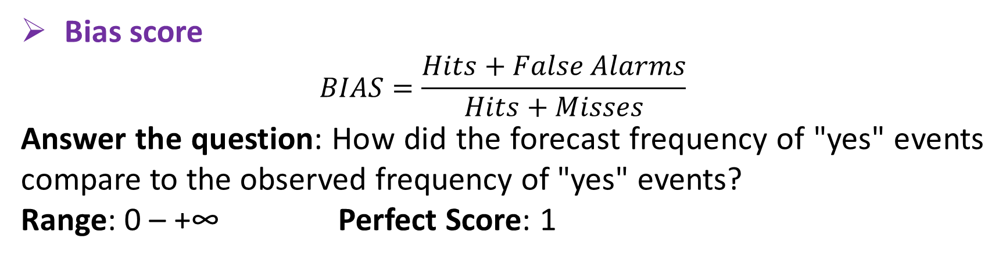
Forecast and Estimates Verification for July 2018
Verification Methods for Dichotomous Forecasts
Bias score
$$BIAS=\frac{Hits+False Alarms}{Hits+Misses}$$
Answer the question: How did the forecast frequency of "yes" events compare to the observed frequency of "yes" events?
Range: 0 – +∞ Perfect Score: 1

Slide 41
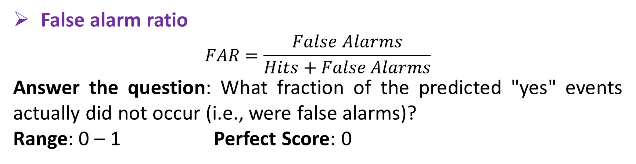
Forecast and Estimates Verification for July 2018
Verification Methods for Dichotomous Forecasts
False alarm ratio
$$FAR=\frac{False Alarms}{Hits+False Alarms}$$
Answer the question: What fraction of the predicted "yes" events actually did not occur (i.e., were false alarms)?
Range: 0 – 1 Perfect Score: 0

Slide 42
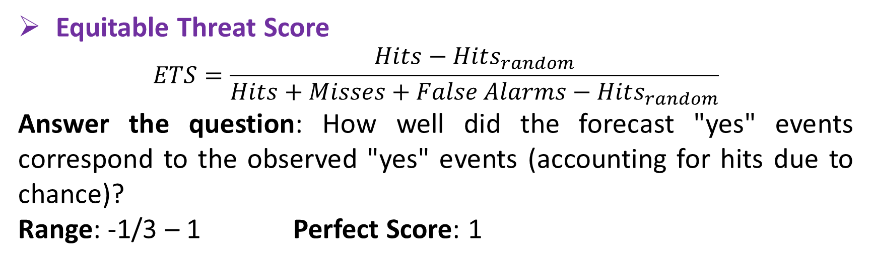
Forecast and Estimates Verification for July 2018
Verification Methods for Dichotomous Forecasts
Equitable Threat Score
$$ETS=\frac{Hits−Hits_{random}}{Hits+Misses+False Alarms−Hits_{random}}$$
Answer the question: How well did the forecast "yes" events correspond to the observed "yes" events (accounting for hits due to chance)?
Range: -1/3 – 1 Perfect Score: 1

Slide 43
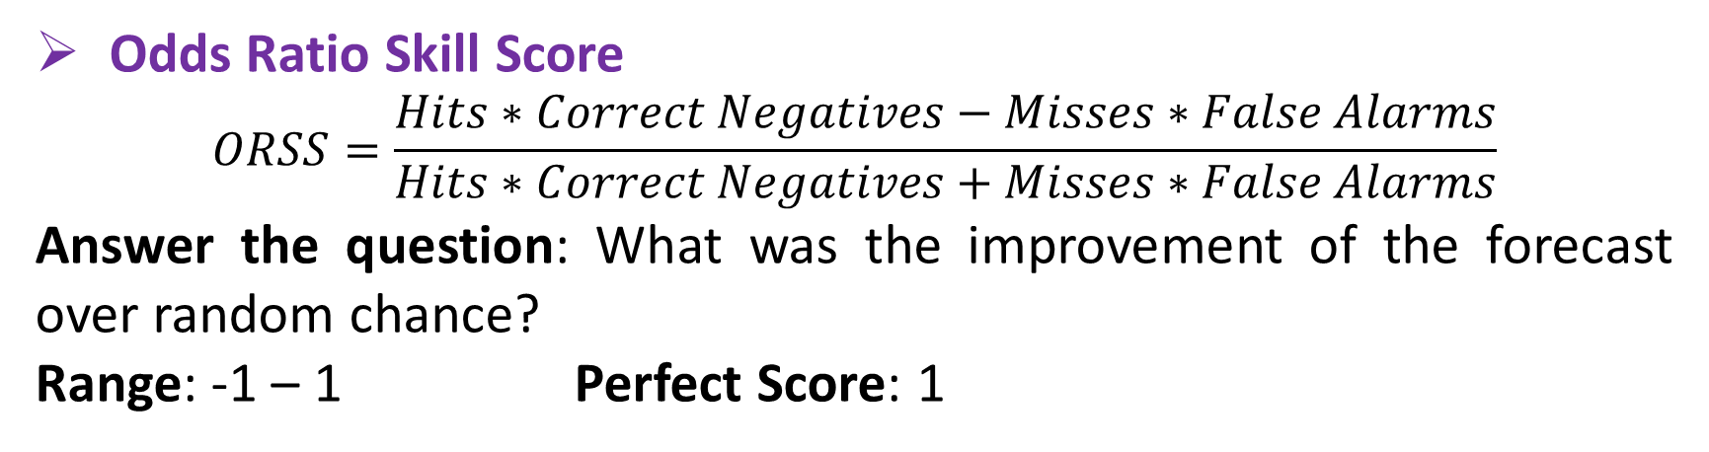
Forecast and Estimates Verification for July 2018
Verification Methods for Dichotomous Forecasts
Odds Ratio Skill Score
$$ORSS=\frac{Hits∗Correct Negatives−Misses∗False Alarms}{Hits∗Correct Negatives+Misses∗False Alarms}$$
Answer the question: What was the improvement of the forecast over random chance?
Range: -1 – 1 Perfect Score: 1

Slide 44
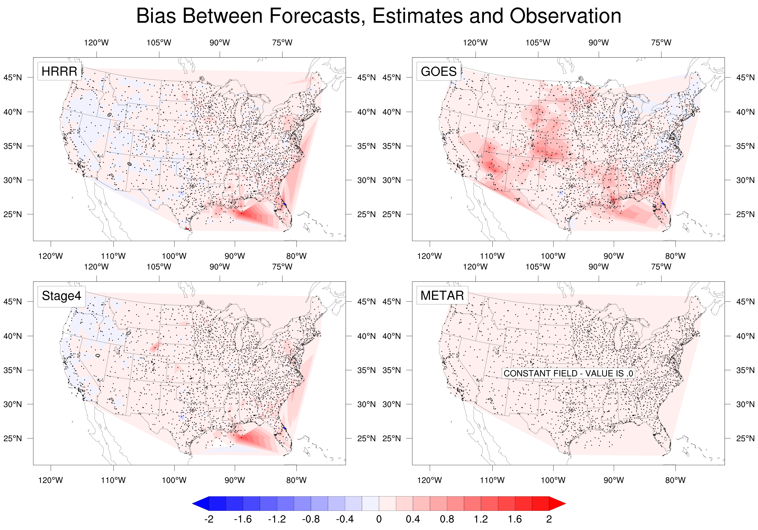
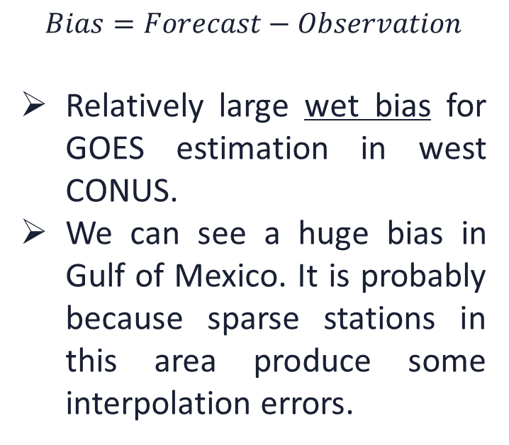
Forecast and Estimates Verification for July 2018
Figure: Bias Map Between Forecast, Estimates and Observation
$$Bias=Forecast−Observation$$
Relatively large wet bias for GOES estimation in west CONUS.
We can see a huge bias in Gulf of Mexico. It is probably because sparse stations in this area produce some interpolation errors.
HRRR
GOES
Stage4
METAR
Notes:
In order to measure the difference between estimation and reference clearly, we calculate the bias and draw the bias map and trend. Positive value means that estimation is larger than reference, which is a wet bias. So we can see these area is in red positive value, which means a wet bias. We can also see some bias in Gulf of Mexico. Because there is very little observation in this area, represented by the black dots, it might introduce some interpolation error when drawing the contour plots. We can ignore them since it is on the sea.

Slide 45
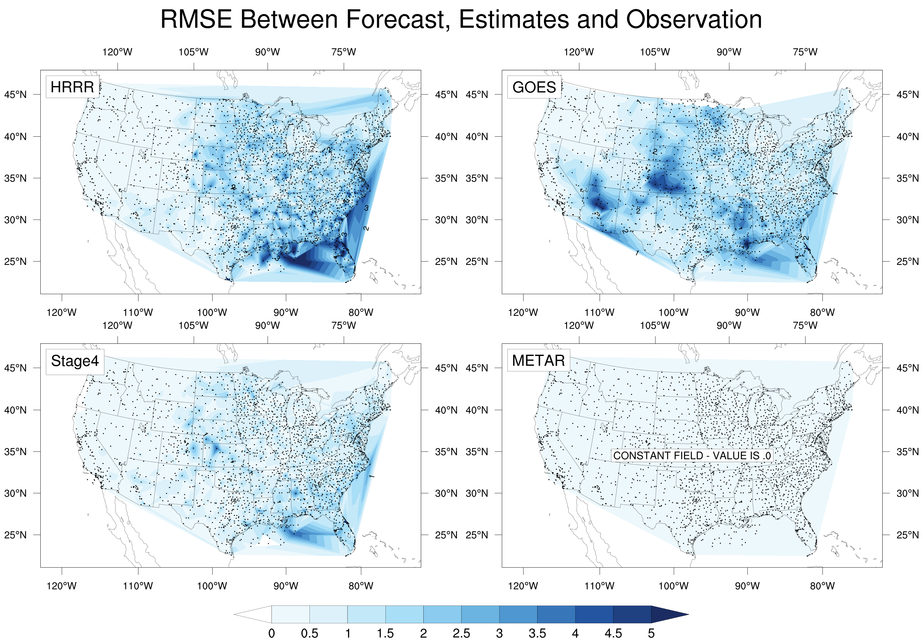
Forecast and Estimates Verification for July 2018
Figure: RMSE Map Between Forecast, Estimates and Observation
GOES has larger RMSE, which supports the analyses before.
We can see a huge bias in Gulf of Mexico. It is probably because sparse stations in this area produce some interpolation errors.
HRRR
GOES
Stage4
METAR
Notes:
For root mean squared error, we also know that GOES has a larger bias, which supports the analyses before.

Slide 46
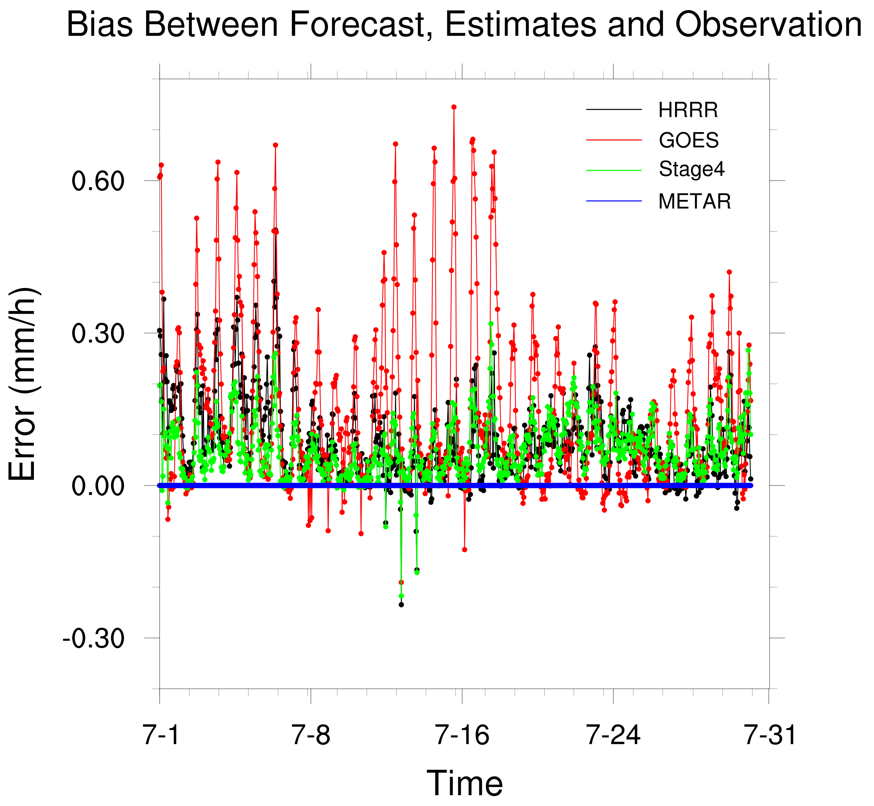
Forecast and Estimates Verification for July 2018
Figure: Bias Trend Between Forecast, Estimates and Observation
Using METAR as reference, bias between METAR and reference is absolute zero.
All forecasts and estimates show a wet bias, with the GOES having the largest bias.
Diurnal variation can also be found in the plot.
HRRR
GOES
Stage4
METAR
Notes:
For the trend, as is similar with the average rainfall trend, diurnal variation can also be found in this plot. So it may indicate that the bias value may have a relationship with rainfall rate.

Slide 47
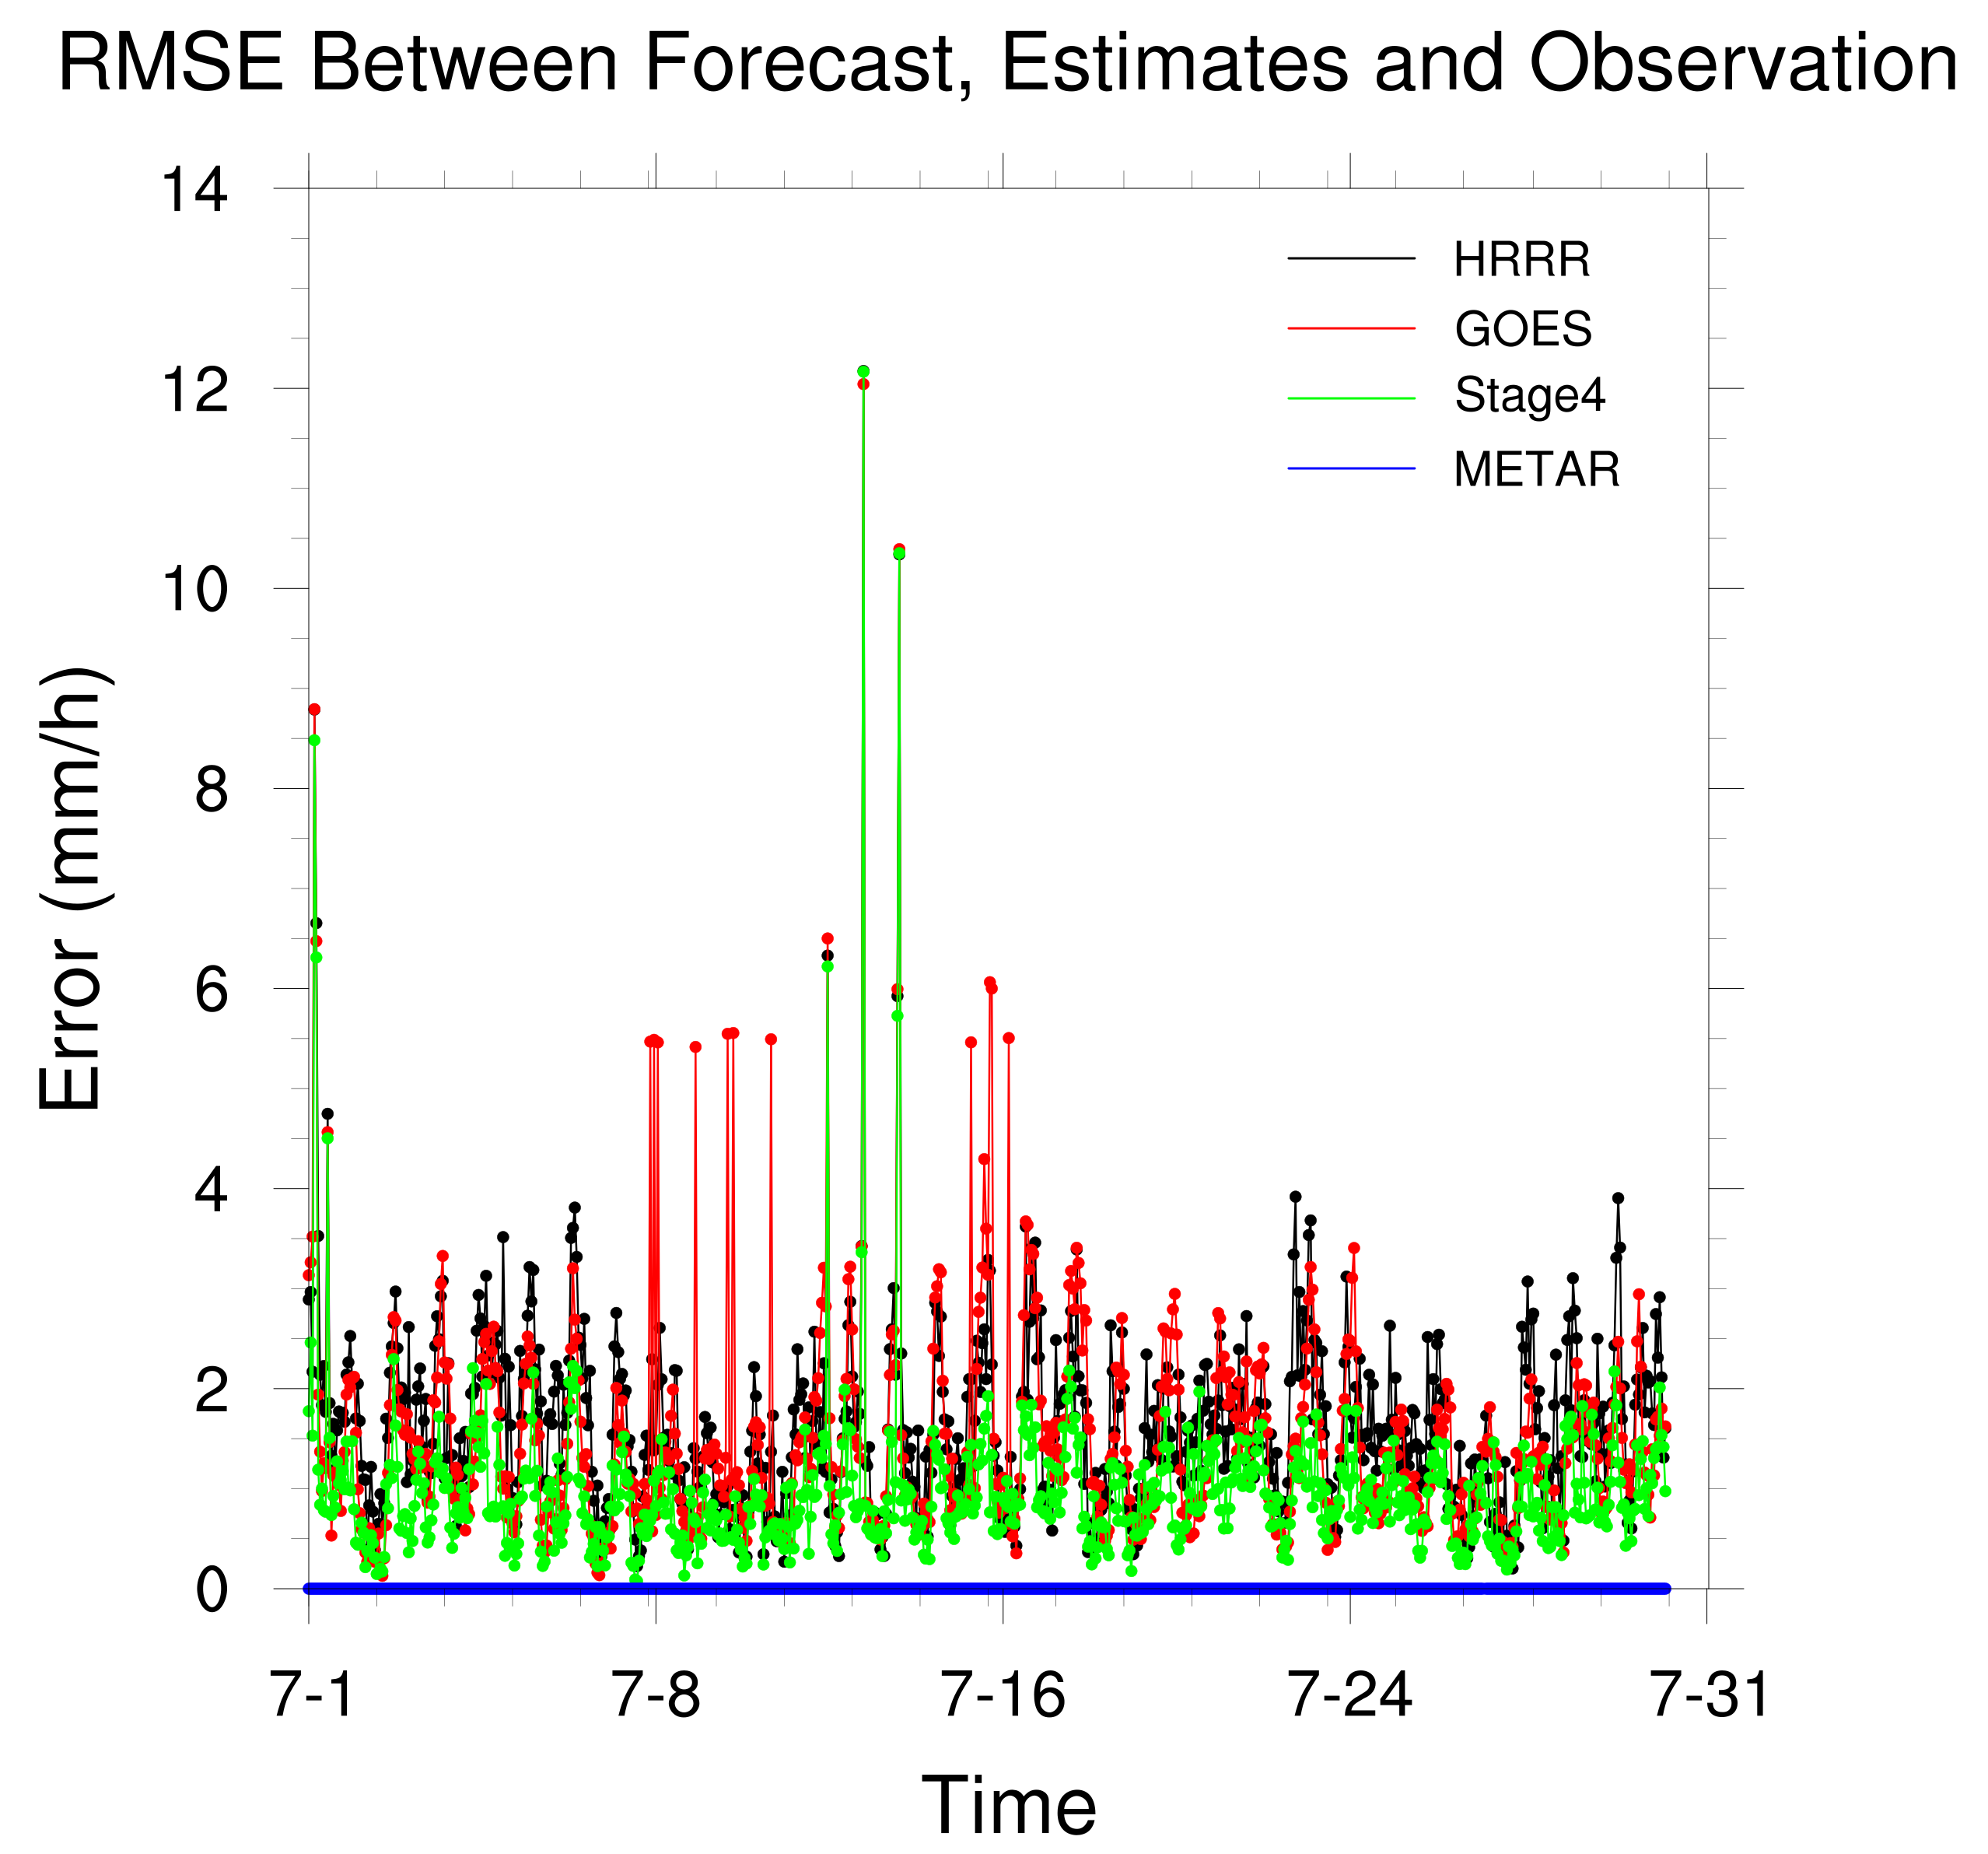
Forecast and Estimates Verification for July 2018
Figure: RMSE Trend Between Forecast, Estimates and Observation
Using METAR as reference, RMSE between METAR and reference is absolute zero.
In most cases, RMSE for GOES and HRRR are larger than Stage4.
Occasionally, GOES has a bigger RMSE value than HRRR.
HRRR
GOES
Stage4
METAR
Notes:
But for the RMSE trend the variation is not apparent. And we can see that the RMSE for these four datasets are very close. Generally StageIV has a better performance than HRRR and GOES.

Slide 48
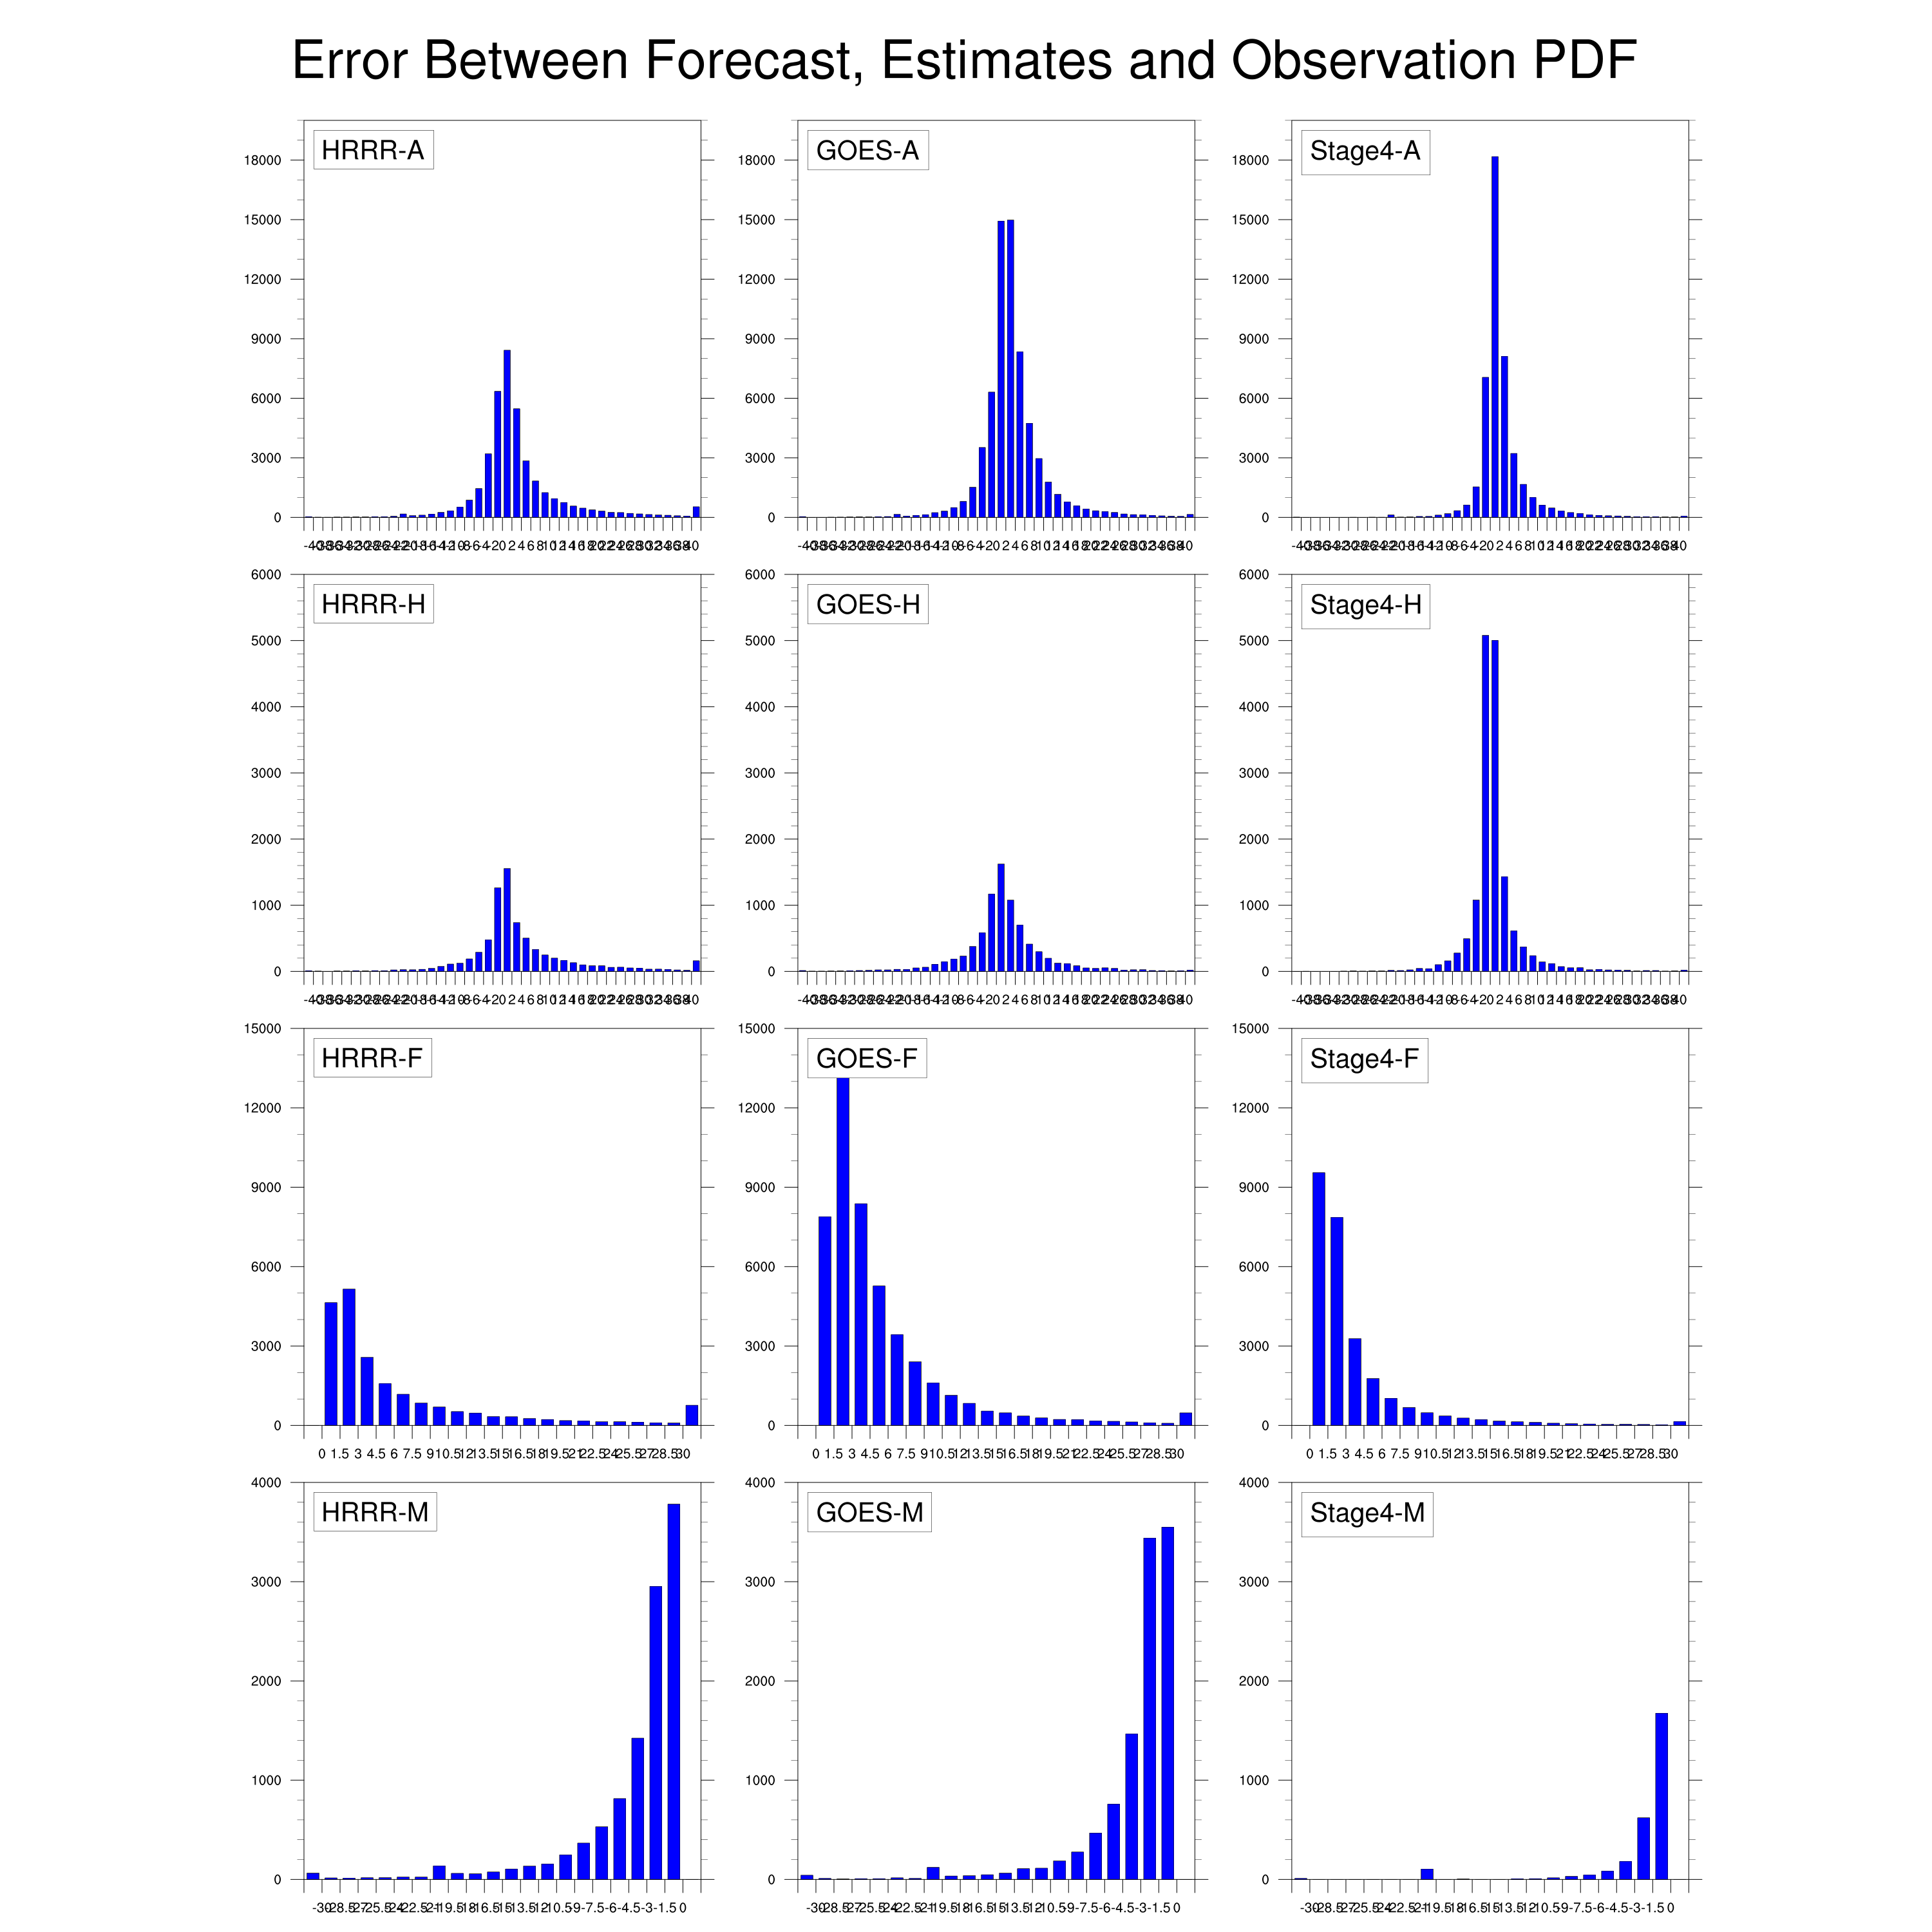
Forecast and Estimates Verification for July 2018
Figure: Error PDF in Different Categories
Zero Line
All except Correct Negatives
False Alarms Only
Hits Only
Misses Only
HRRR
GOES
Stage4
HRRR
GOES
Stage4
Slight wet bias is discovered in the first row.
Most of the wet bias for the GOES estimate comes from false alarms.
Notes:
We can also draw the error PDF for these categories. As we know in the error statistics, there is a slight wet bias in all four datasets. And we notice in the GOES plot that the bars are taller than other two datasets, indicating that most of the wet bias for the GOES estimate comes from here.

Slide 49
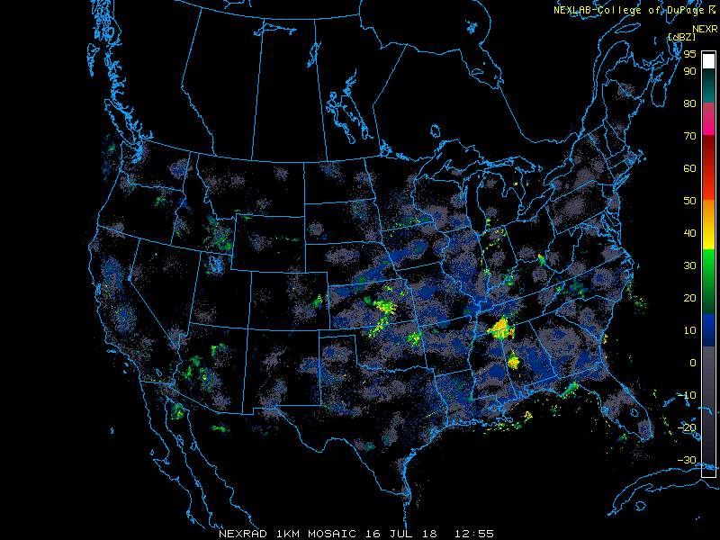
Result Analyses
Case study: Convective processes on July 16th.
Data from 1 pm July 16th to 11 pm July 17th are selected.

Slide 50
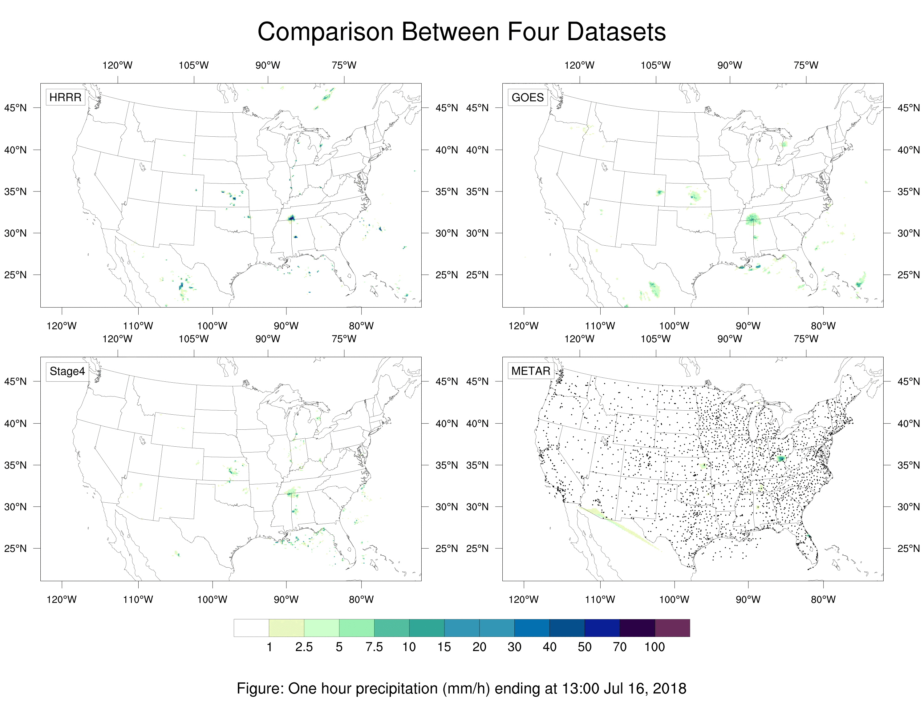
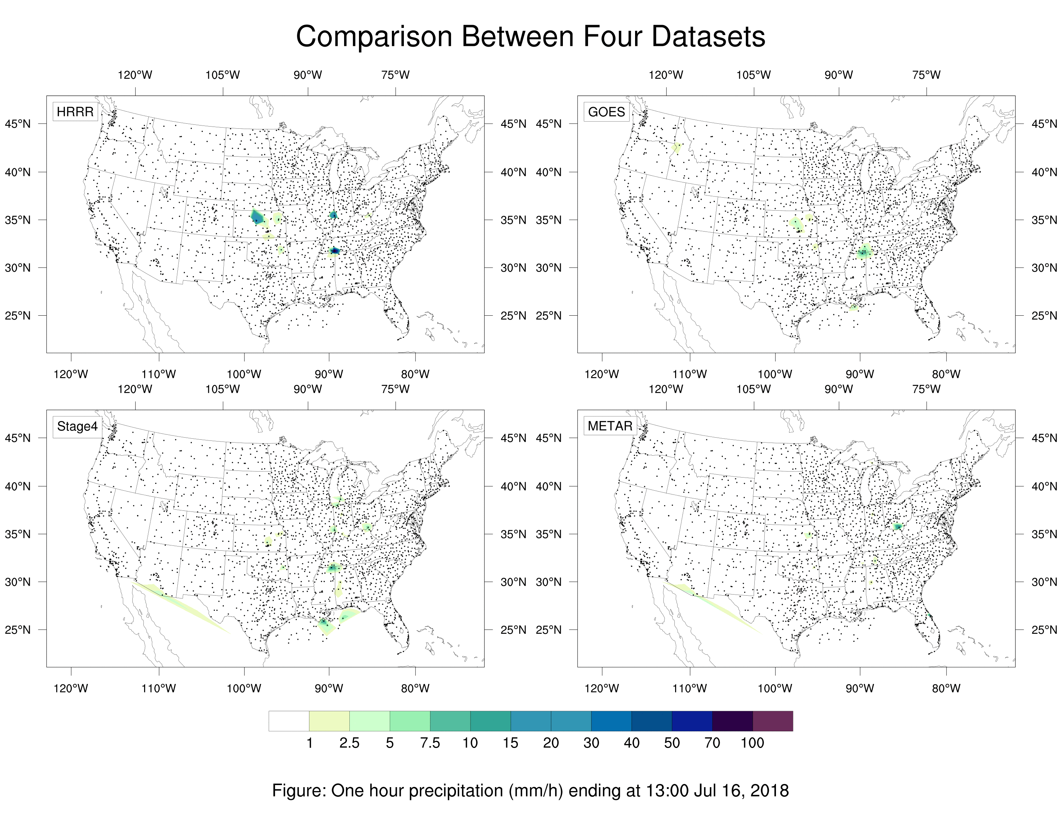
Case Study: Convective Processes on July 16th
Figure: One hour precipitation before and after interpolation
Before Interpolation
After Interpolation

Slide 51
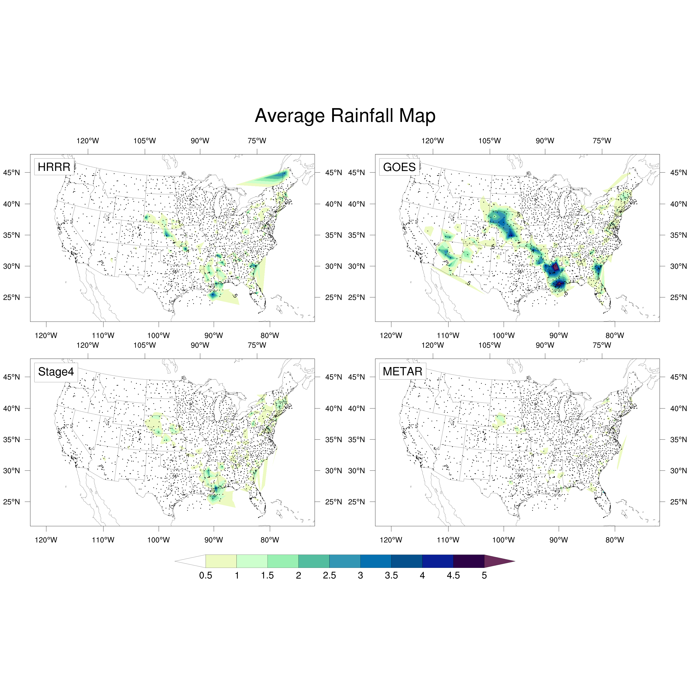
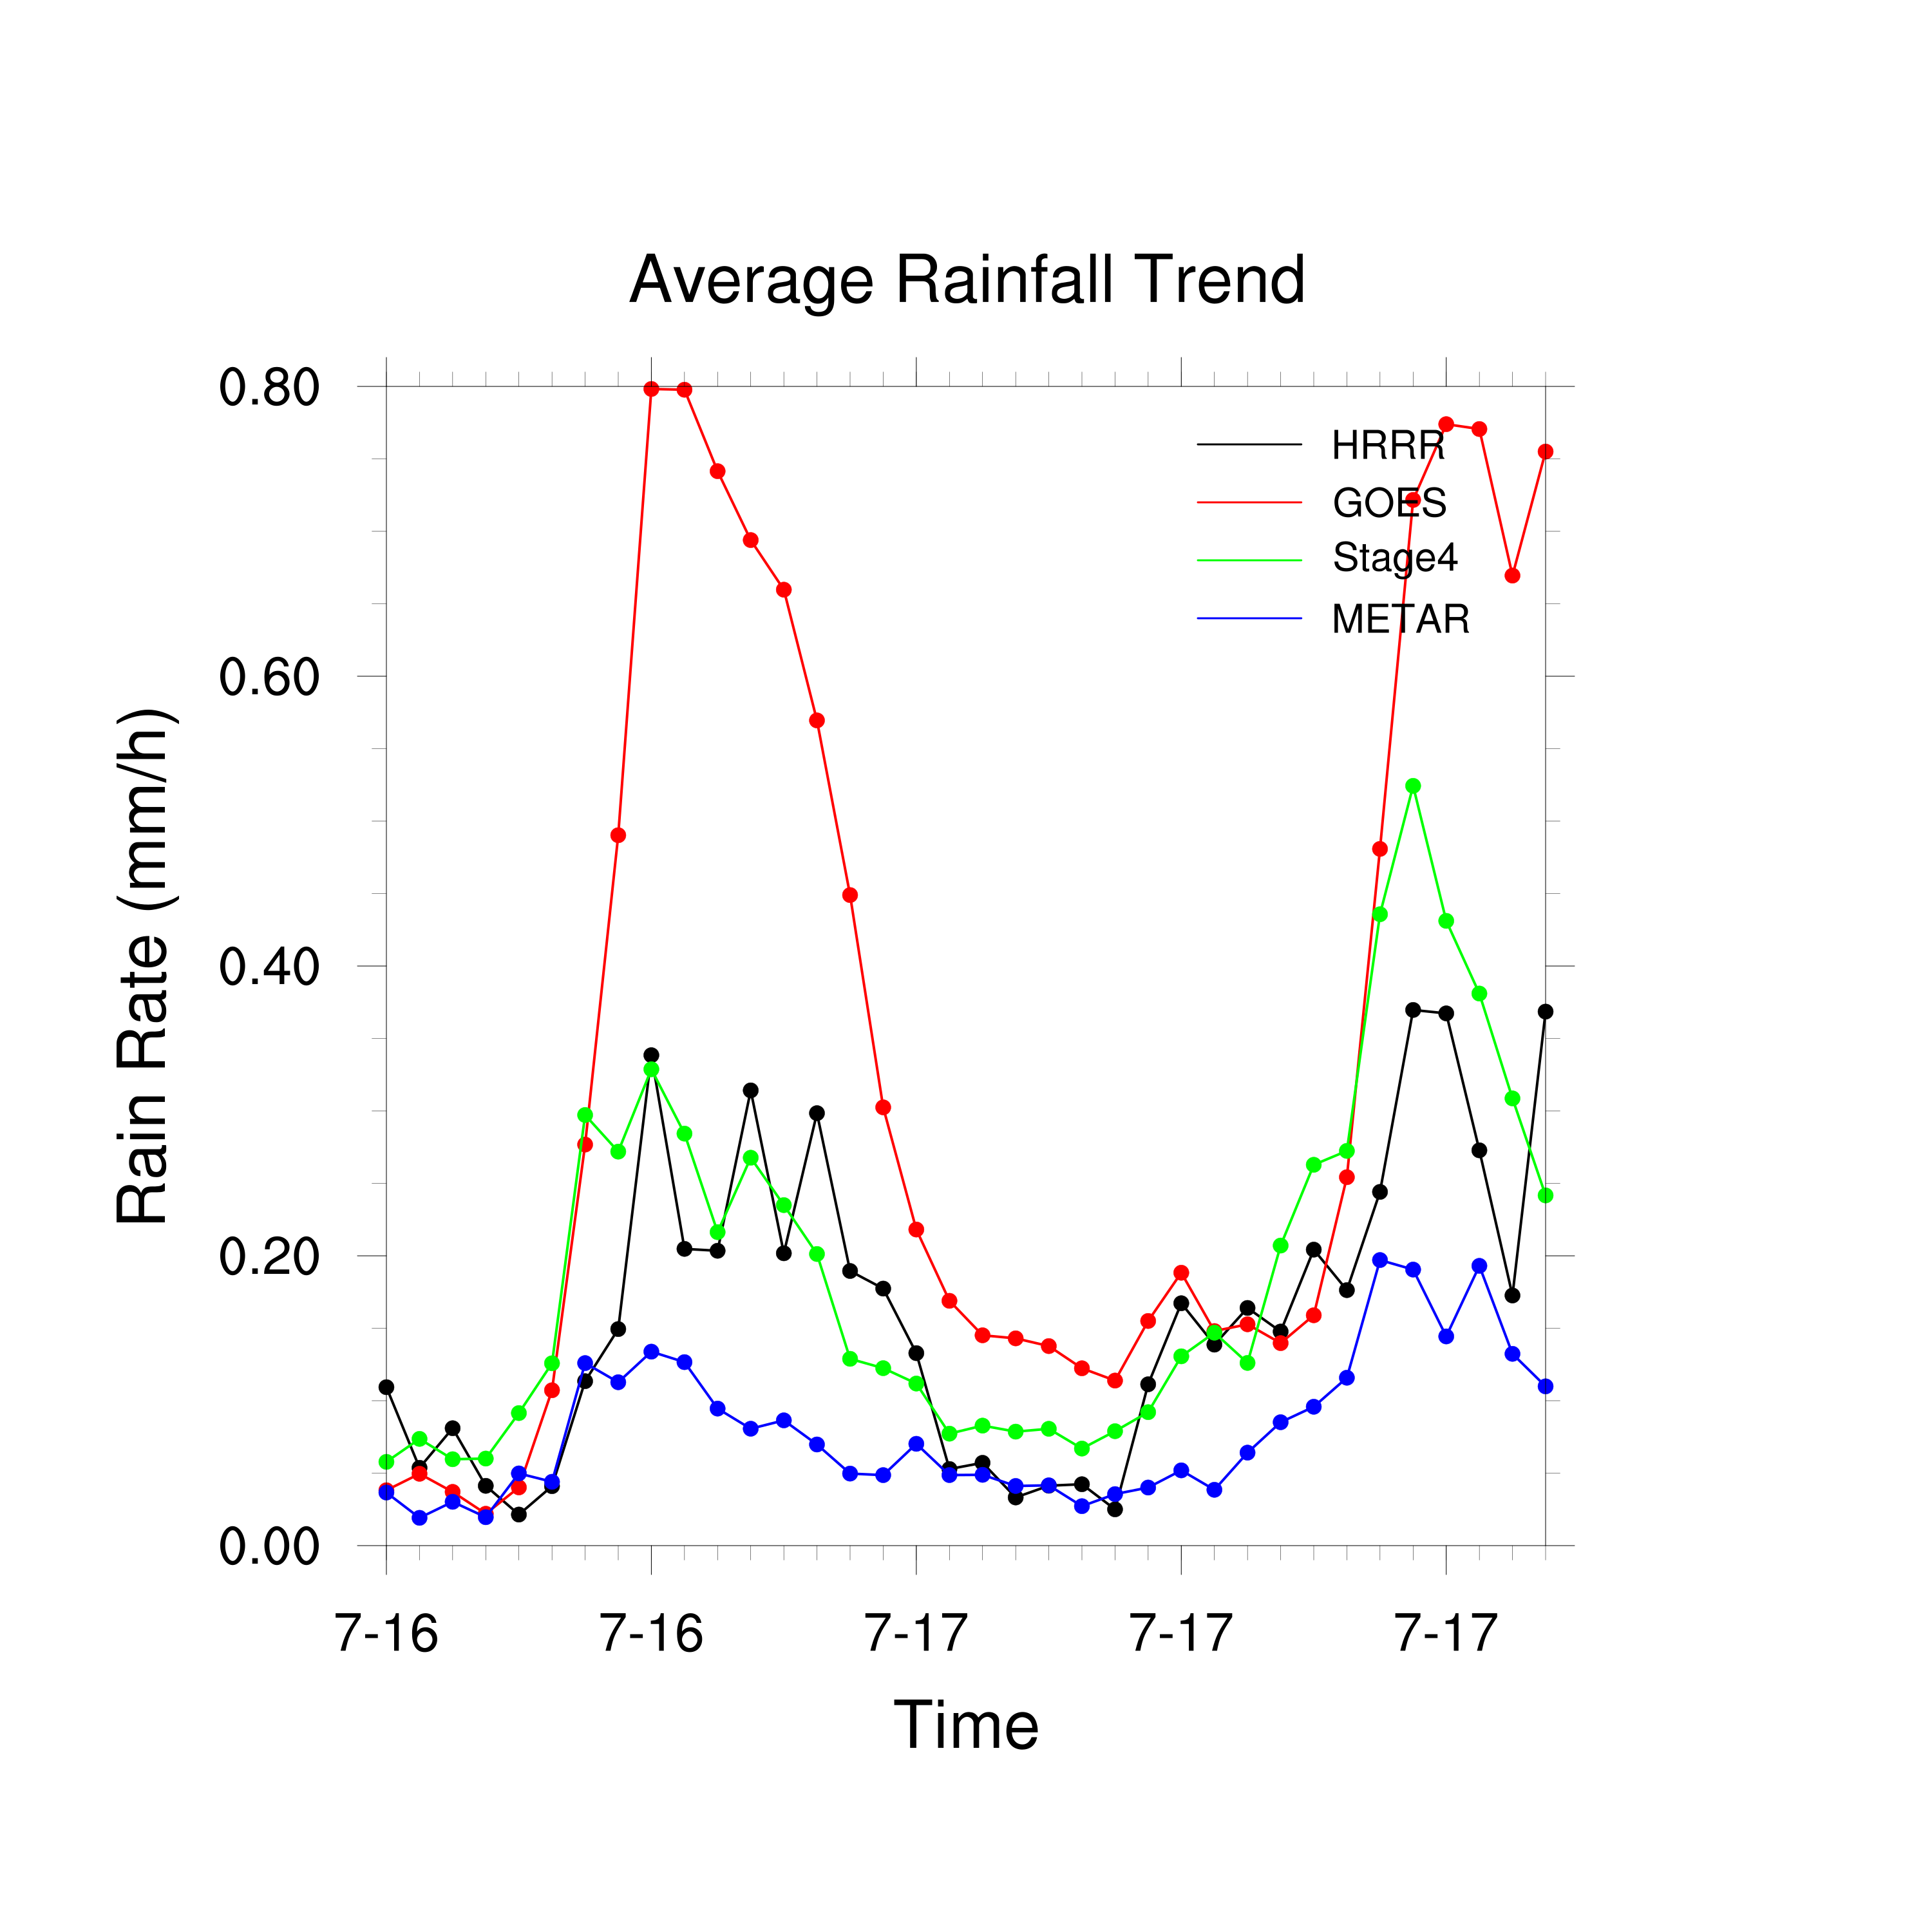
Case Study: Convective Processes on July 16th
Figure: Average Rainfall Map and Trend
HRRR
GOES
Stage4
METAR

Slide 52
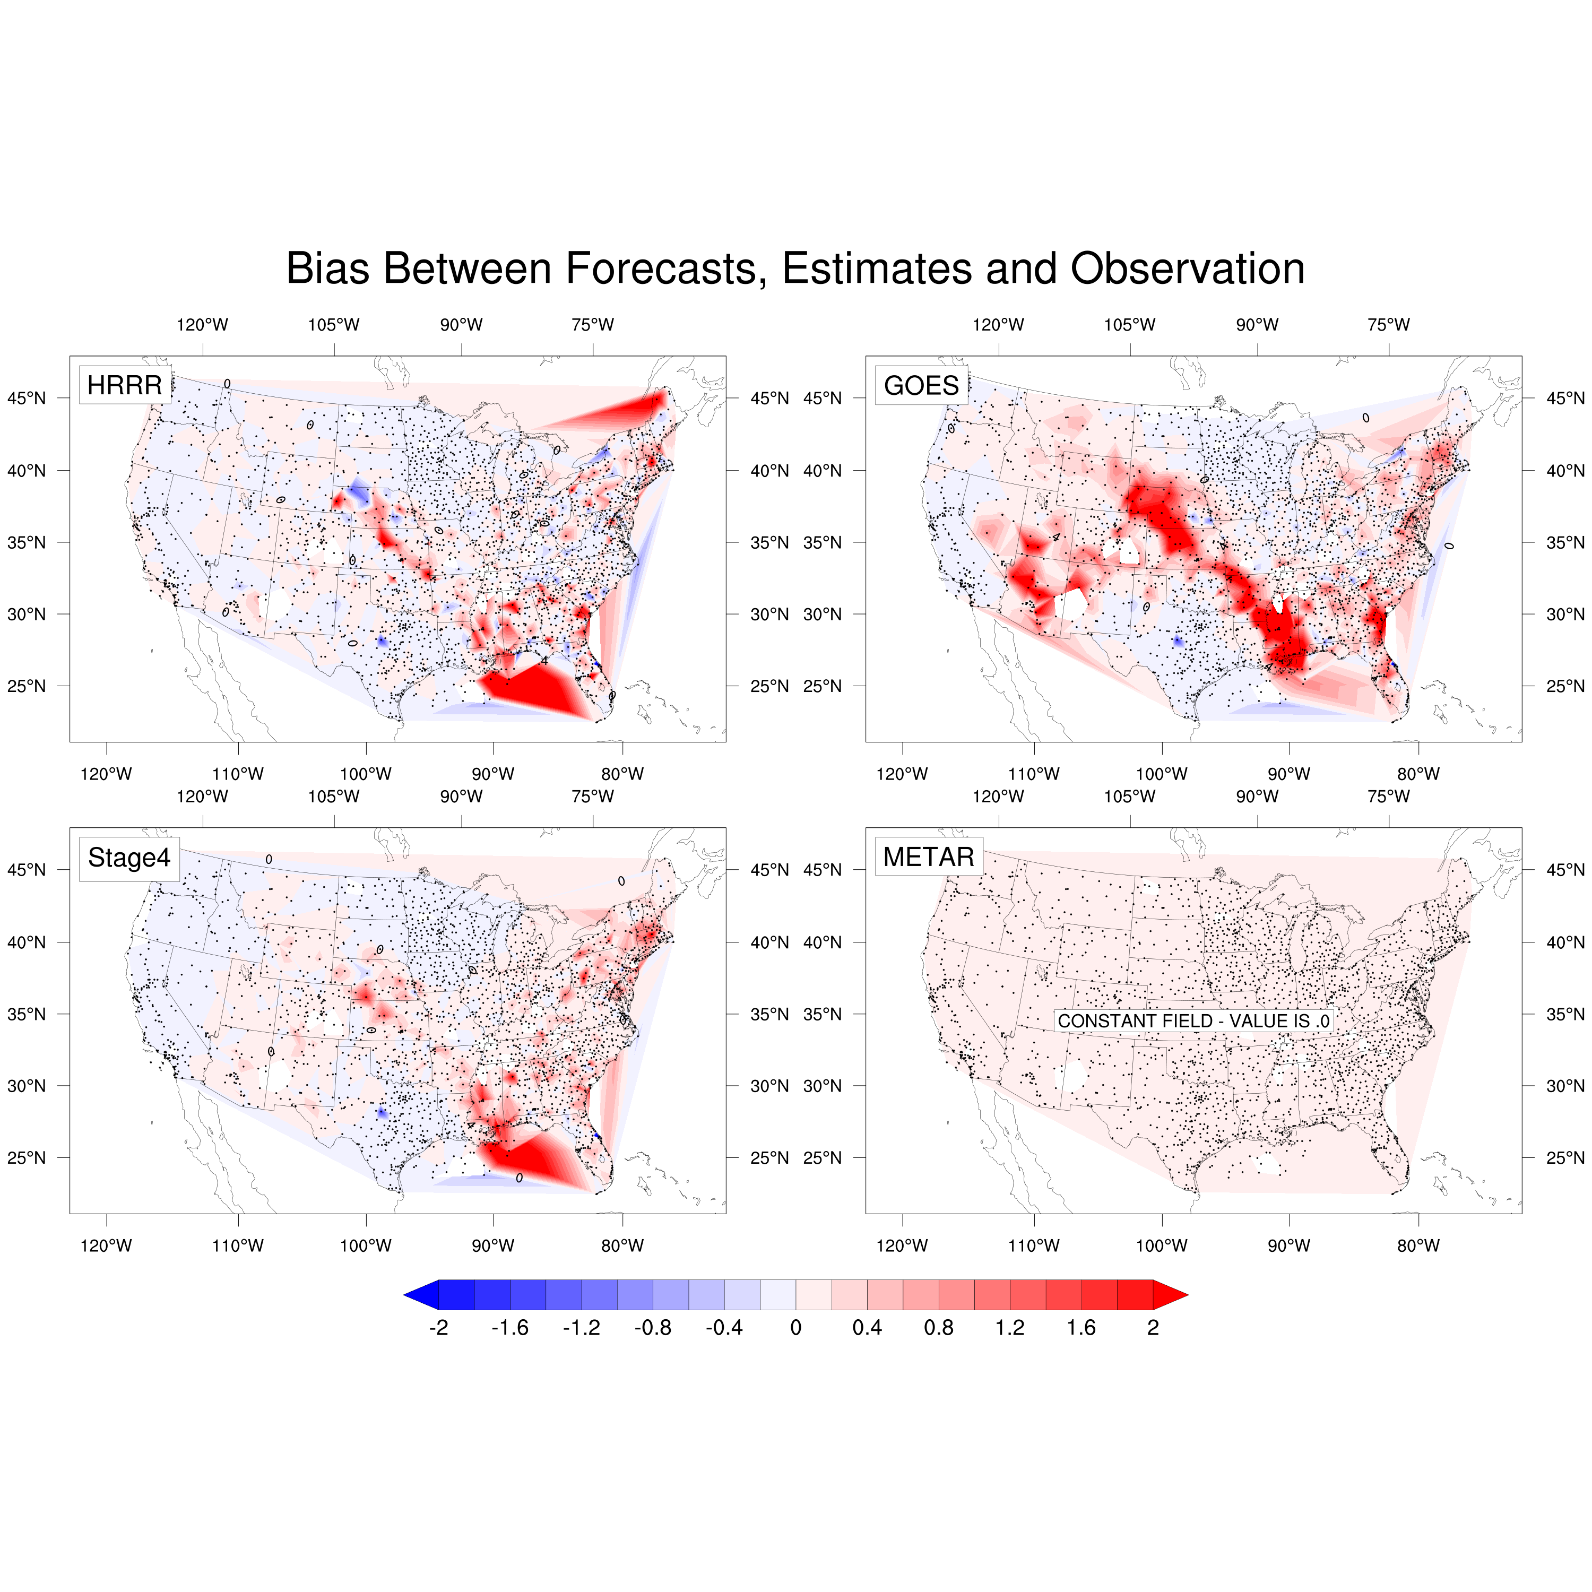
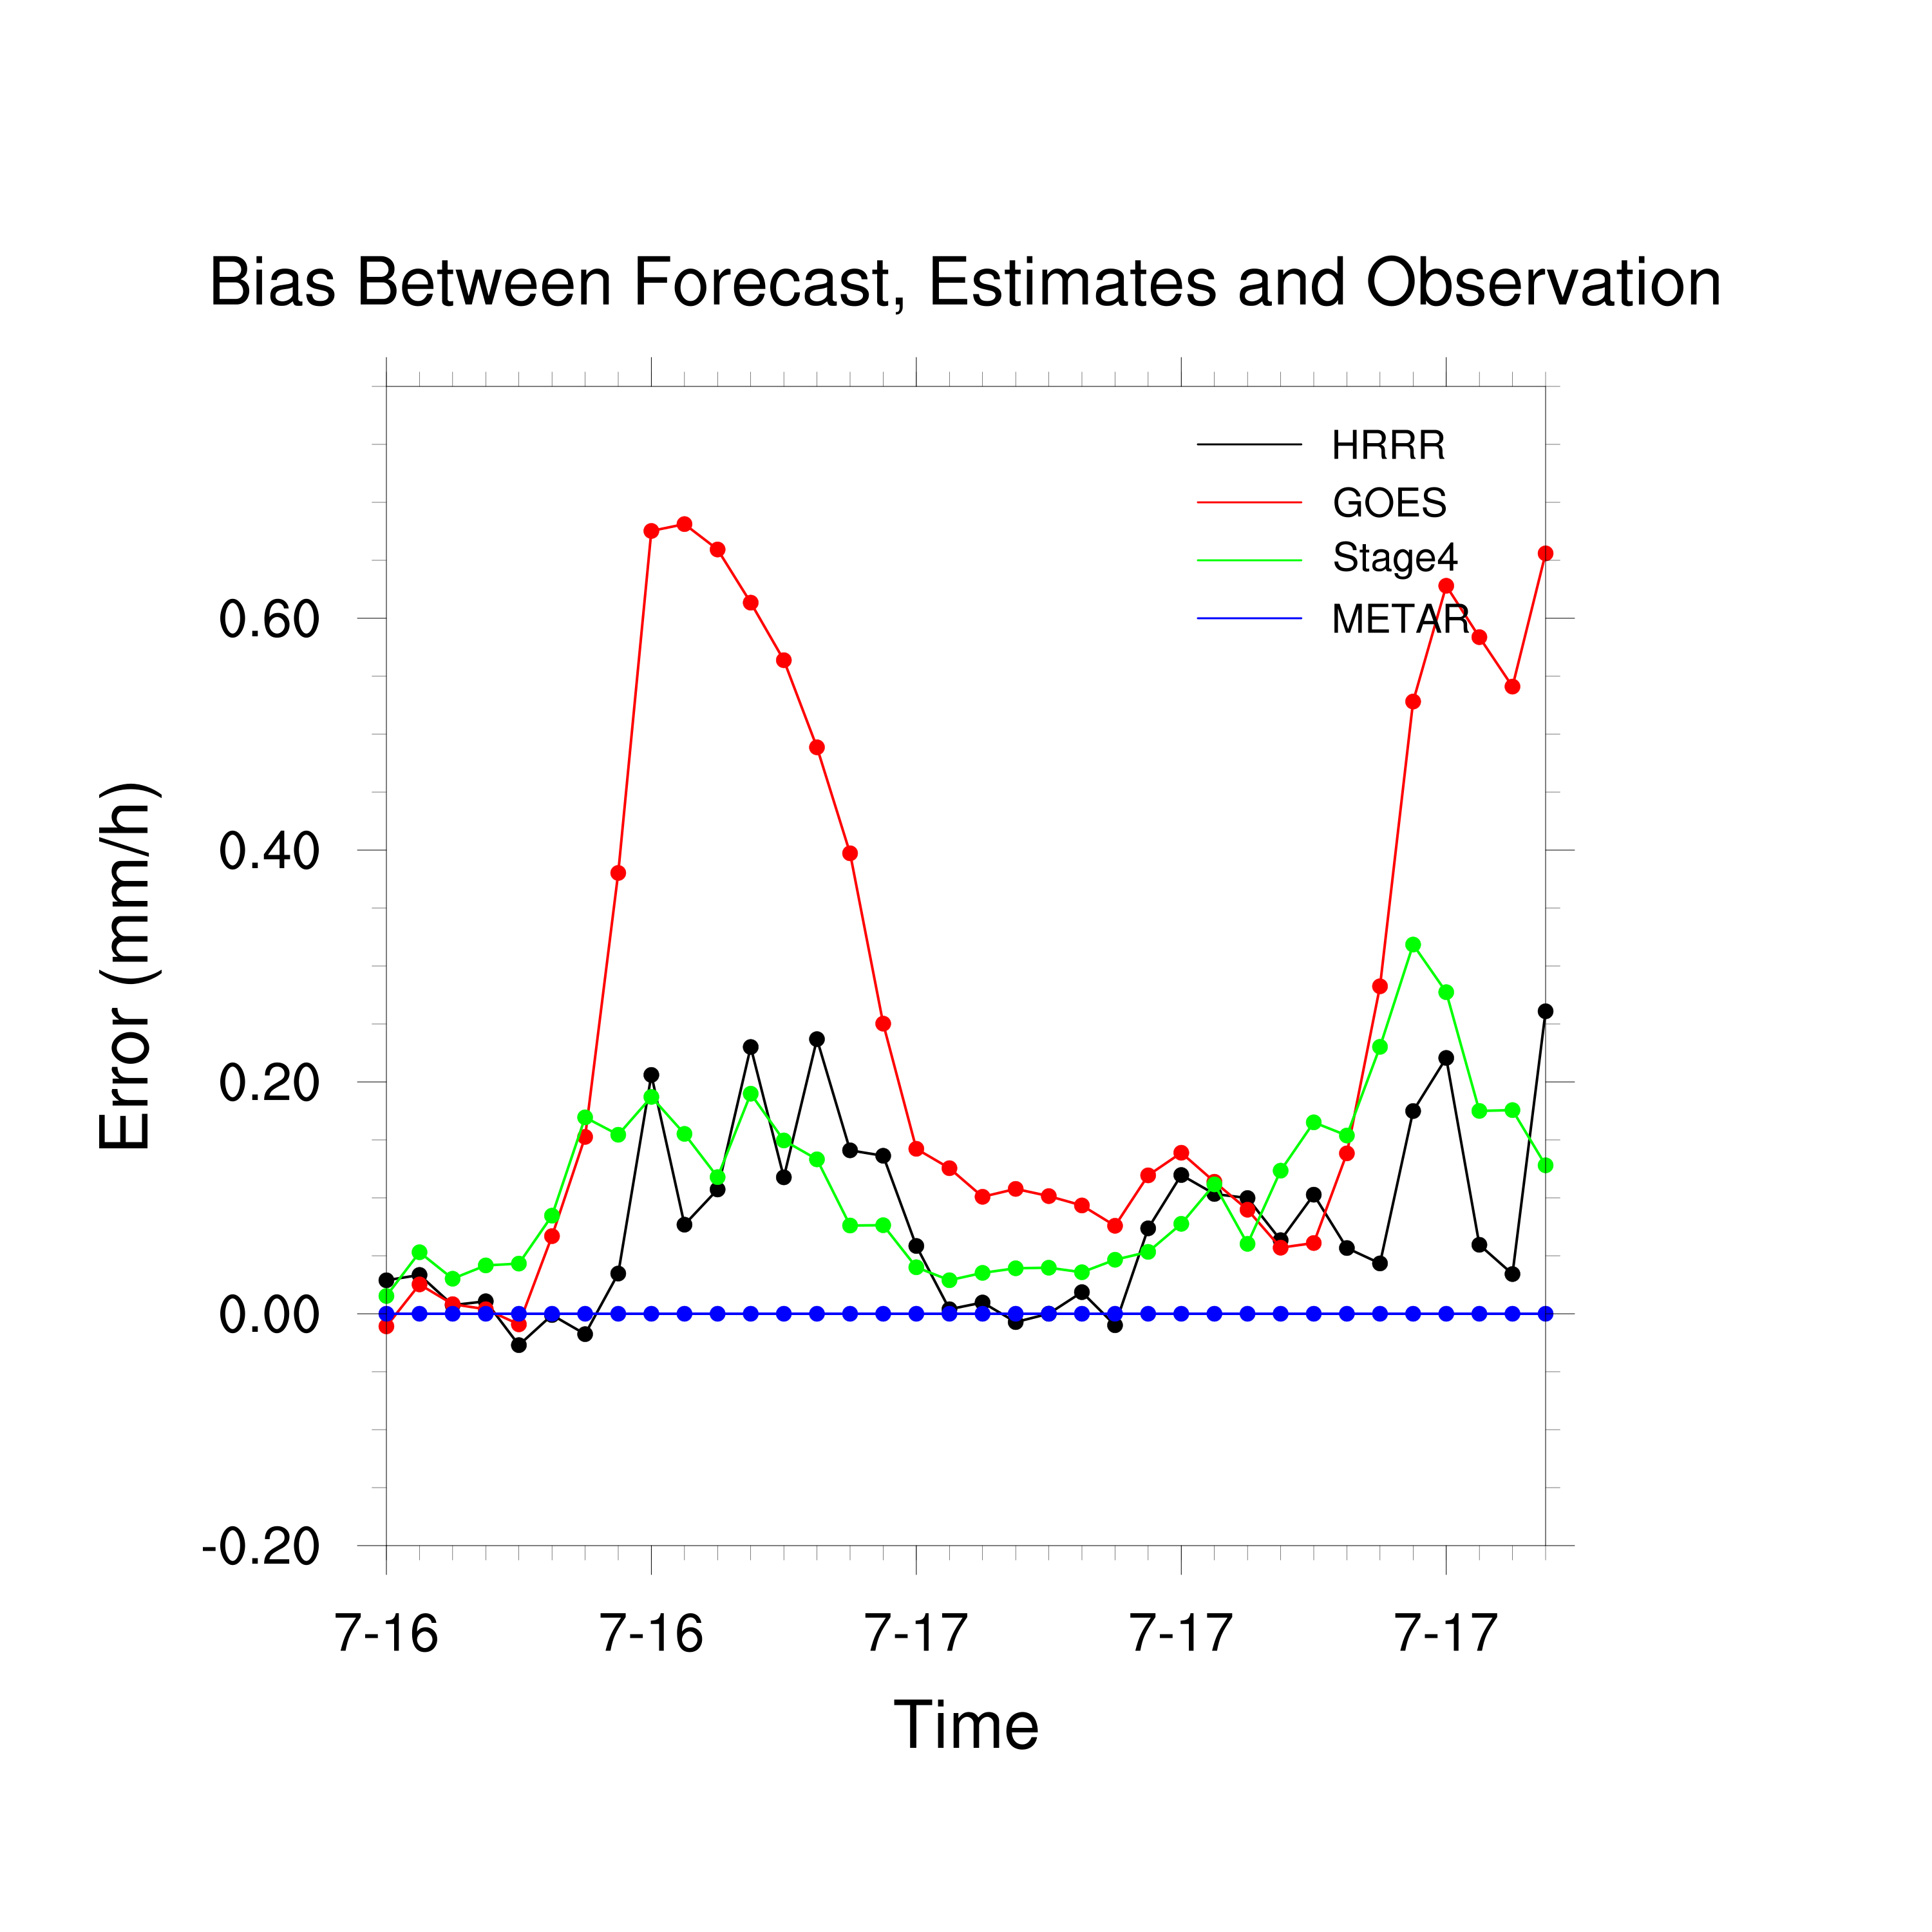
Case Study: Convective Processes on July 16th
Figure: Bias Map and Trend Between Forecast, Estimates and Observation
HRRR
GOES
Stage4
METAR

Slide 53
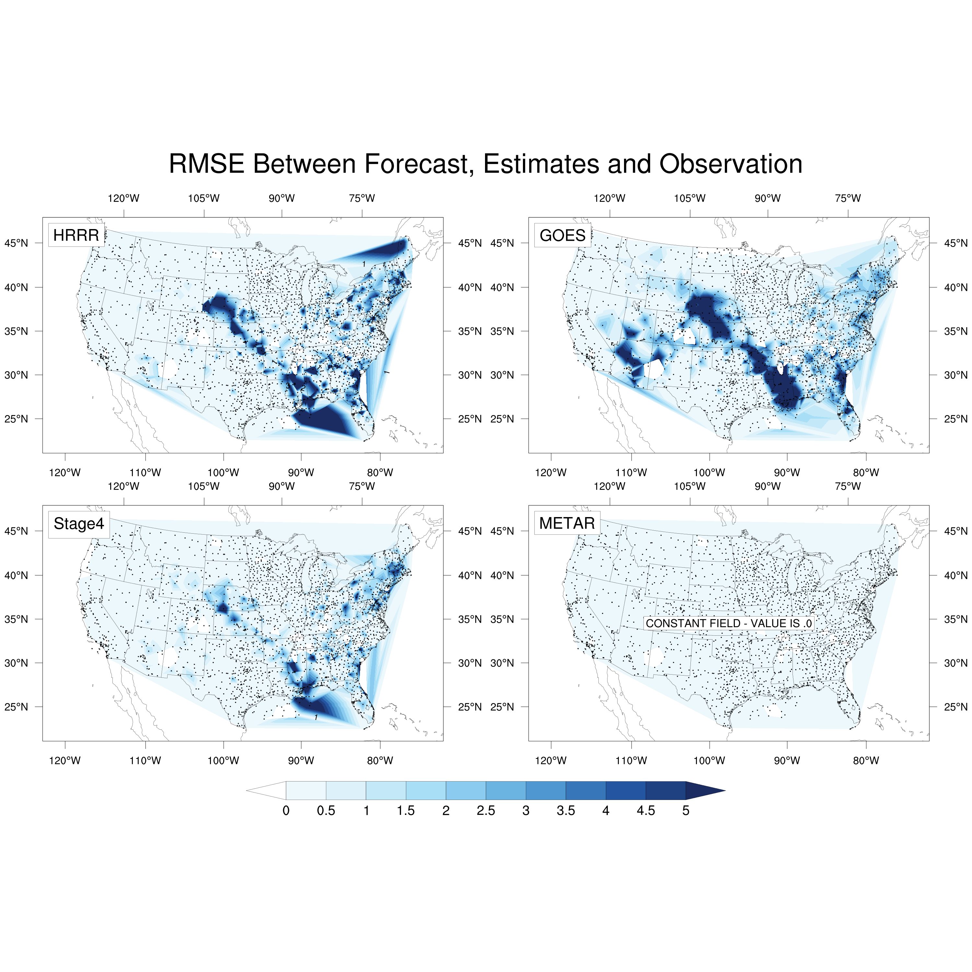
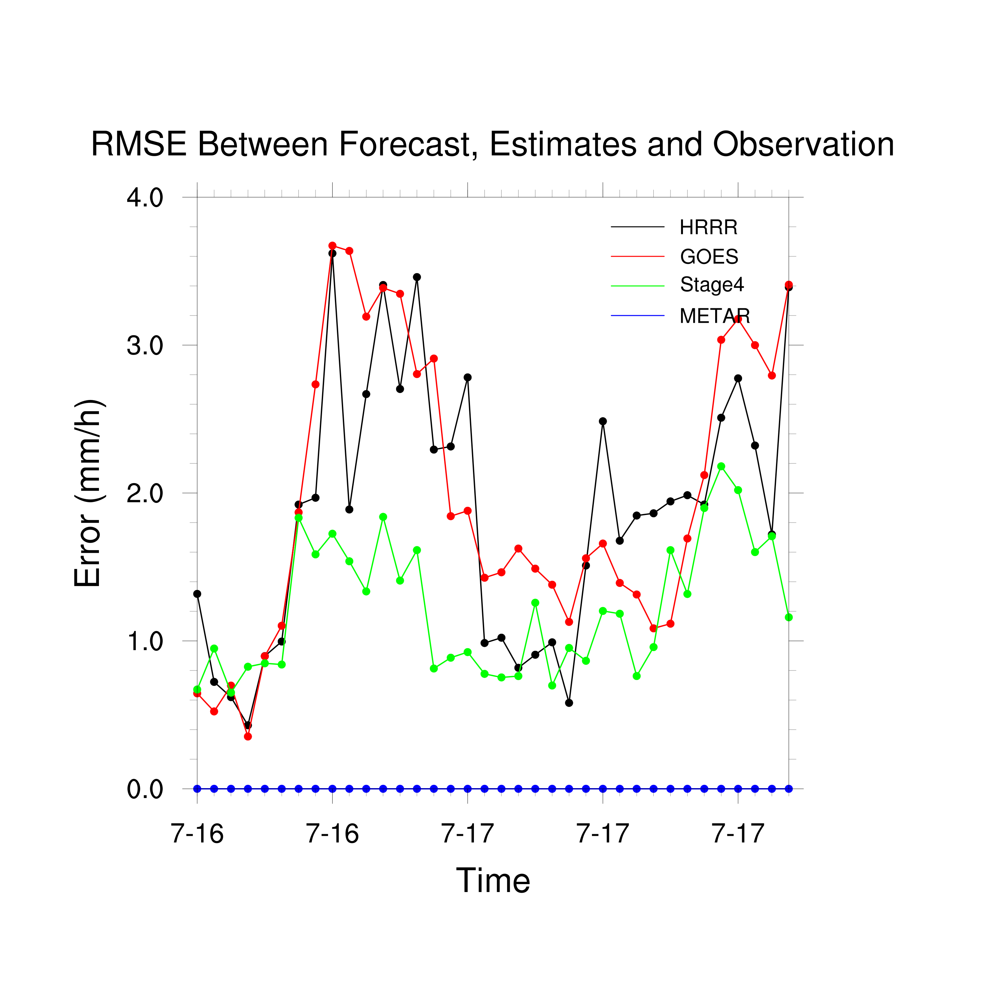
Case Study: Convective Processes on July 16th
Figure: RMSE Map Between Forecast, Estimates and Observation
HRRR
GOES
Stage4
METAR

